Slide 1
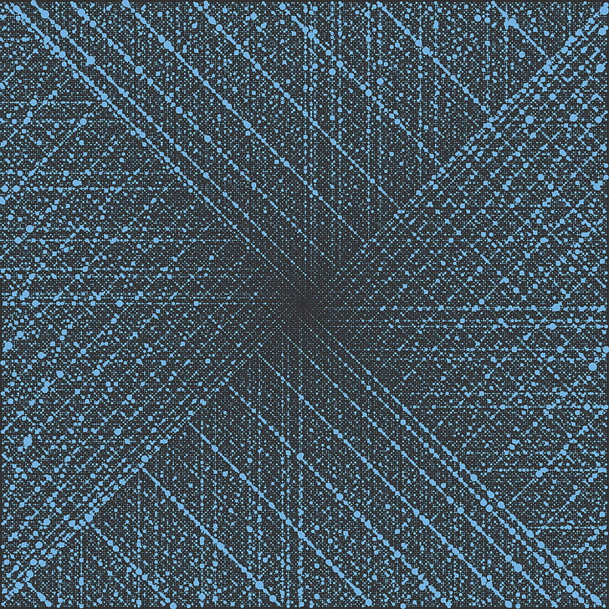
Chapter 7
Mathematical
Background
Part II

Slide 2
Outlines
Prime and Composite Numbers.
Euler’s and Fermat’s Little Theorems.
Prime Numbers and Primality Testing.
Chinese Remainder Theorem.
Fast Exponentiation Algorithm.

Slide 3
Learning Objectives
In the end of this Chapter 7, students will be able:
To understand the difference between prime and composite numbers.
To understand and apply the Euler’s and Fermat’s Little Theorems.
To perform primality tests on prime numbers.
To understand and apply the Chinese Remainder Theorem to solve congruence equations.
To understand and perform fast exponentiation operation using fast exponentiation algorithm.

Slide 4
PRIME AND COMPOSITE NUMBERS

Slide 5
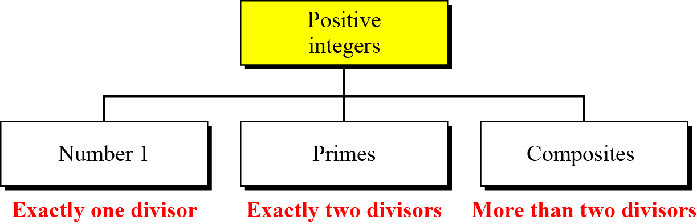
Prime and Composite Numbers
In general, positive integers can be divided into three groups:
The number 1. (It has exactly 1 divisor, which is 1 itself)
Prime numbers. (It has exactly 2 divisors, which are 1 and itself)
Composite Numbers. (It has more than 2 divisors)

Slide 6
Prime and Composite Numbers
Definition 1:
A positive integer is a prime if and only if it has exactly two divisors, 1 and itself. Otherwise, it is a composite.
Theorem 2:
There are infinitely many prime numbers.

Slide 7
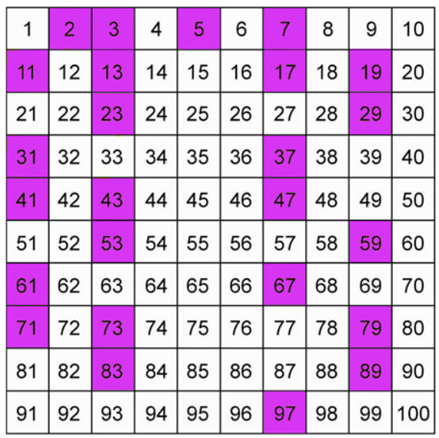

Prime and Composite Numbers
Examples of prime numbers less than 100.
The purple coloured indicate the primes, while the rest are composite numbers
Note:
Number $2$ is the smallest and the only even prime number.
We will learn how to determine small prime numbers later.

Slide 8
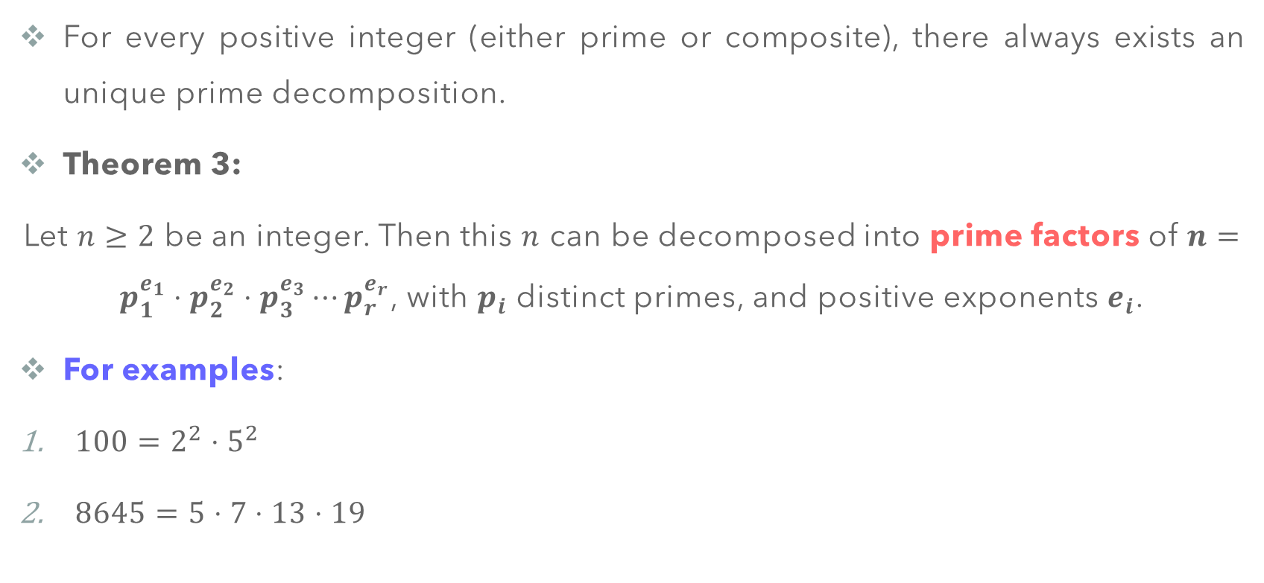
Prime and Composite Numbers
For every positive integer (either prime or composite), there always exists an unique prime decomposition.
Theorem 3:
Let $n≥2$ be an integer. Then this $n$ can be decomposed into prime factors of $n=p_{1}^{e_{1}}⋅p_{2}^{e_{2}}⋅p_{3}^{e_{3}}⋯p_{r}^{e_{r}}$, with $p_{i}$ distinct primes, and positive exponents $e_{i}$.
For examples:
$100=2^{2}⋅5^{2}$
$8645=5⋅7⋅13⋅19$

Slide 9
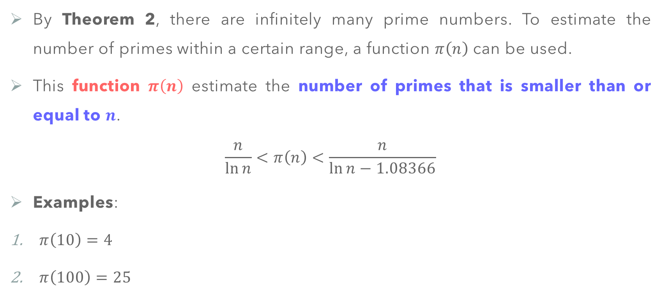
Prime Numbers – Cardinality
By Theorem 2, there are infinitely many prime numbers. To estimate the number of primes within a certain range, a function $π\left(n\right)$ can be used.
This function $π\left(n\right)$ estimate the number of primes that is smaller than or equal to $n$.
$$\frac{n}{\ln{n}}<π\left(n\right)<\frac{n}{\ln{n}−1.08366}$$
Examples:
$π\left(10\right)=4$
$π\left(100\right)=25$

Slide 10
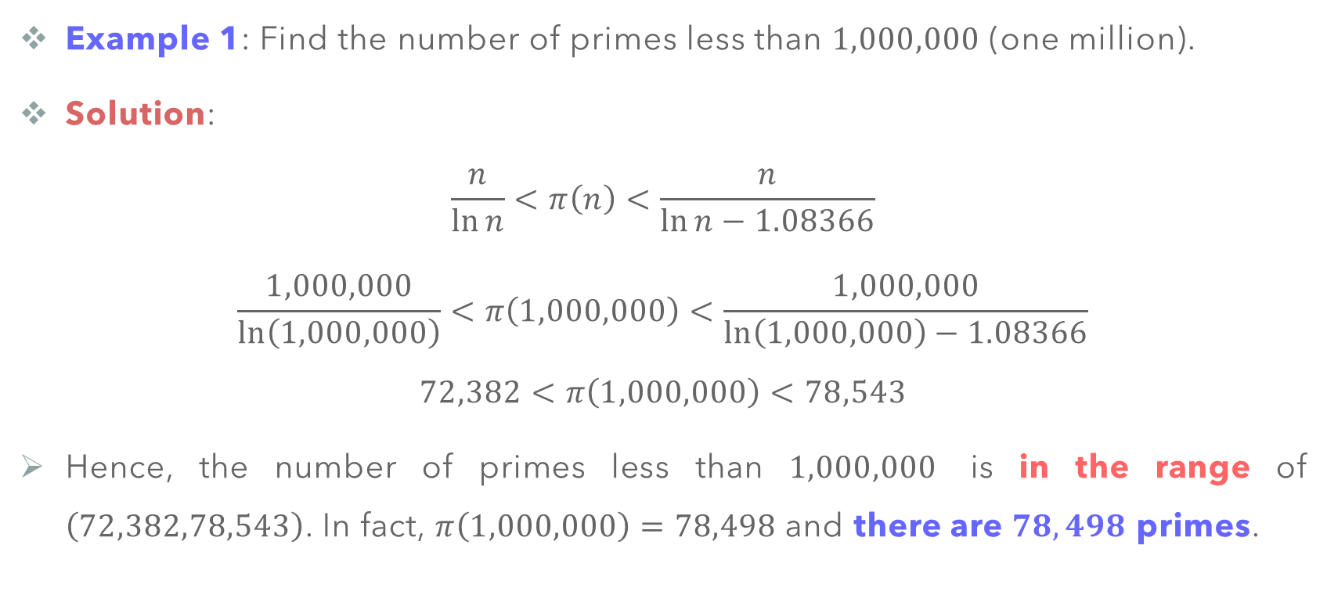
Prime Numbers – Cardinality
Example 1: Find the number of primes less than $1,000,000$ (one million).
Solution:
$$\frac{n}{\ln{n}}<π\left(n\right)<\frac{n}{\ln{n}−1.08366}$$
$$\frac{1,000,000}{\ln\left(1,000,000\right)}<π\left(1,000,000\right)<\frac{1,000,000}{\ln\left(1,000,000\right)−1.08366}$$
$$72,382<π\left(1,000,000\right)<78,543$$
Hence, the number of primes less than $1,000,000$ is in the range of $\left(72,382,78,543\right)$. In fact, $π\left(1,000,000\right)=78,498$ and there are $78,498$ primes.

Slide 11
EULER’S AND FERMAT’S LITTLE THEOREMS

Slide 12
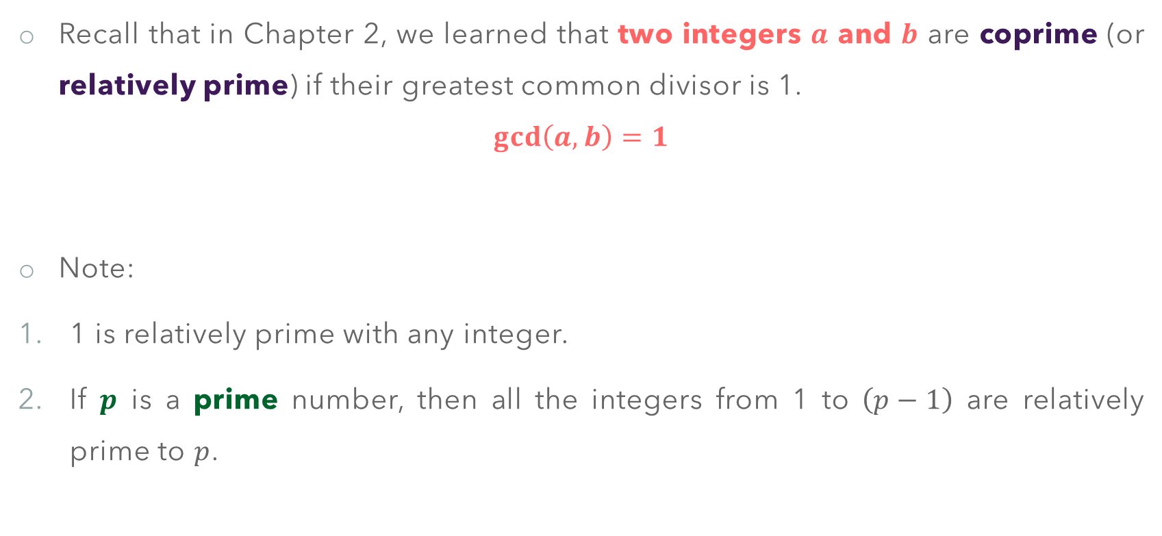
Preliminary – Coprime
Recall that in Chapter 2, we learned that two integers $a$ and $b$ are coprime (or relatively prime) if their greatest common divisor is 1.
$$\gcd\left(a,b\right)=1$$
Note:
1 is relatively prime with any integer.
If $p$ is a prime number, then all the integers from 1 to $\left(p−1\right)$ are relatively prime to $p$.

Slide 13
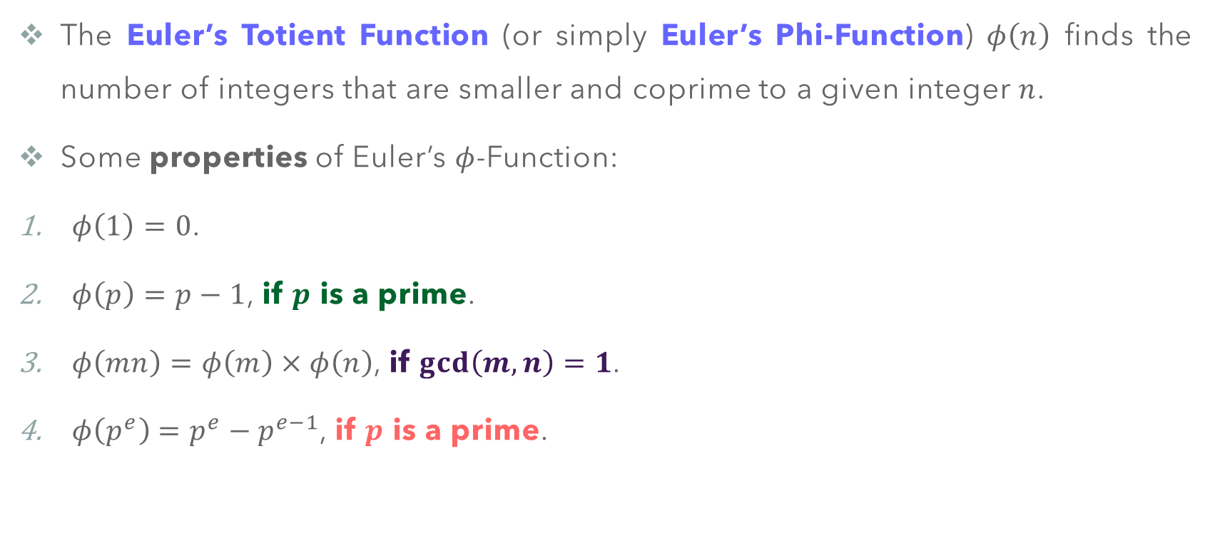
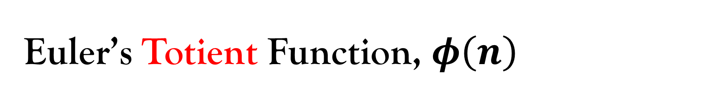
Euler’s Totient Function, $φ\left(n\right)$
The Euler’s Totient Function (or simply Euler’s Phi-Function) $φ\left(n\right)$ finds the number of integers that are smaller and coprime to a given integer $n$.
Some properties of Euler’s $φ$-Function:
$φ\left(1\right)=0$.
$φ\left(p\right)=p−1$, if $p$ is a prime.
$φ\left(mn\right)=φ\left(m\right)×φ\left(n\right)$, if $\gcd\left(m,n\right)=1$.
$φ\left(p^{e}\right)=p^{e}−p^{e−1}$, if $p$ is a prime.

Slide 14

Euler’s Totient Function, $φ\left(n\right)$
From Theorem 3, any integer $n$ can be decomposed as $n=p_{1}^{e_{1}}⋅p_{2}^{e_{2}}⋅p_{3}^{e_{3}}⋯p_{r}^{e_{r}}$. Then, we have:
$$φ\left(n\right)= φ\left(p_{1}^{e_{1}}⋅p_{2}^{e_{2}}⋅p_{3}^{e_{3}}⋯p_{r}^{e_{r}}\right)$$
$$=φ\left(p_{1}^{e_{1}}\right)×φ\left(p_{2}^{e_{2}}\right)×⋯×φ\left(p_{r}^{e_{r}}\right)$$
$$=\left(p_{1}^{e_{1}}−p_{1}^{e_{1}−1}\right)\left(p_{2}^{e_{2}}−p_{2}^{e_{2}−1}\right)⋯\left(p_{r}^{e_{r}}−p_{r}^{e_{r}−1}\right)$$

Slide 15
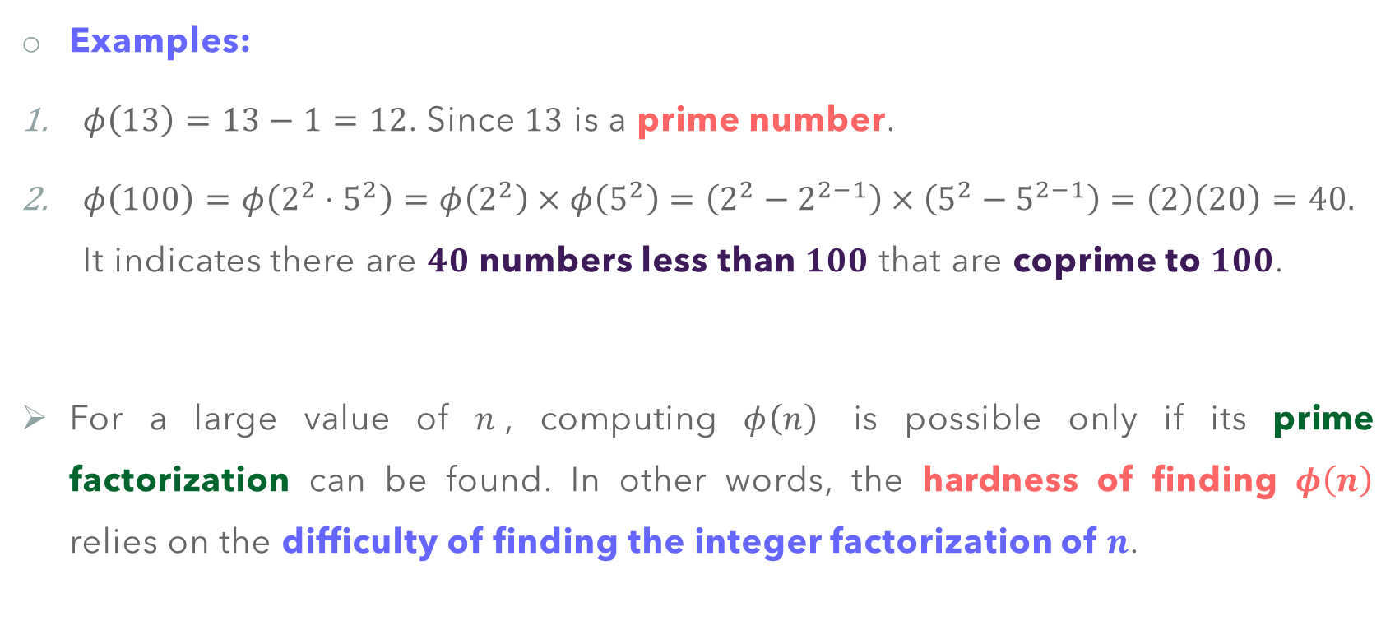
Euler’s Totient Function, $φ\left(n\right)$
Examples:
$φ\left(13\right)=13−1=12$. Since $13$ is a prime number.
$φ\left(100\right)=φ\left(2^{2}⋅5^{2}\right)=φ\left(2^{2}\right)×φ\left(5^{2}\right)=\left(2^{2}−2^{2−1}\right)×\left(5^{2}−5^{2−1}\right)=\left(2\right)\left(20\right)=40.$ It indicates there are $40$ numbers less than $100$ that are coprime to $100$.
For a large value of $n$, computing $φ\left(n\right)$ is possible only if its prime factorization can be found. In other words, the hardness of finding $φ\left(n\right)$ relies on the difficulty of finding the integer factorization of $n$.

Slide 16

Euler’s Totient Function, $φ\left(n\right)$
Common mistake in finding $φ\left(n\right)$.
$φ\left(49\right)=φ\left(7\right)×φ\left(7\right)=\left(7−1\right)\left(7−1\right)=\left(6\right)\left(6\right)=36$. This is INCORRECT, since it does NOT satisfy the property 3 such that $\gcd\left(7,7\right)≠1$. Instead,
$$φ\left(49\right)=φ\left(7^{2}\right)=7^{2}−7^{2−1}=49−7=42$$

Slide 17

Fermat’s Little Theorem
Theorem 4:
If $p$ is a prime and $a$ is a positive integer such that $a∤p$, then
$$a^{p−1}≡1 \left(mod p\right).$$
Corollary 5:
If $p$ is a prime and $a$ is a positive integer, then
$$a^{p}≡a \left(mod p\right).$$

Slide 18
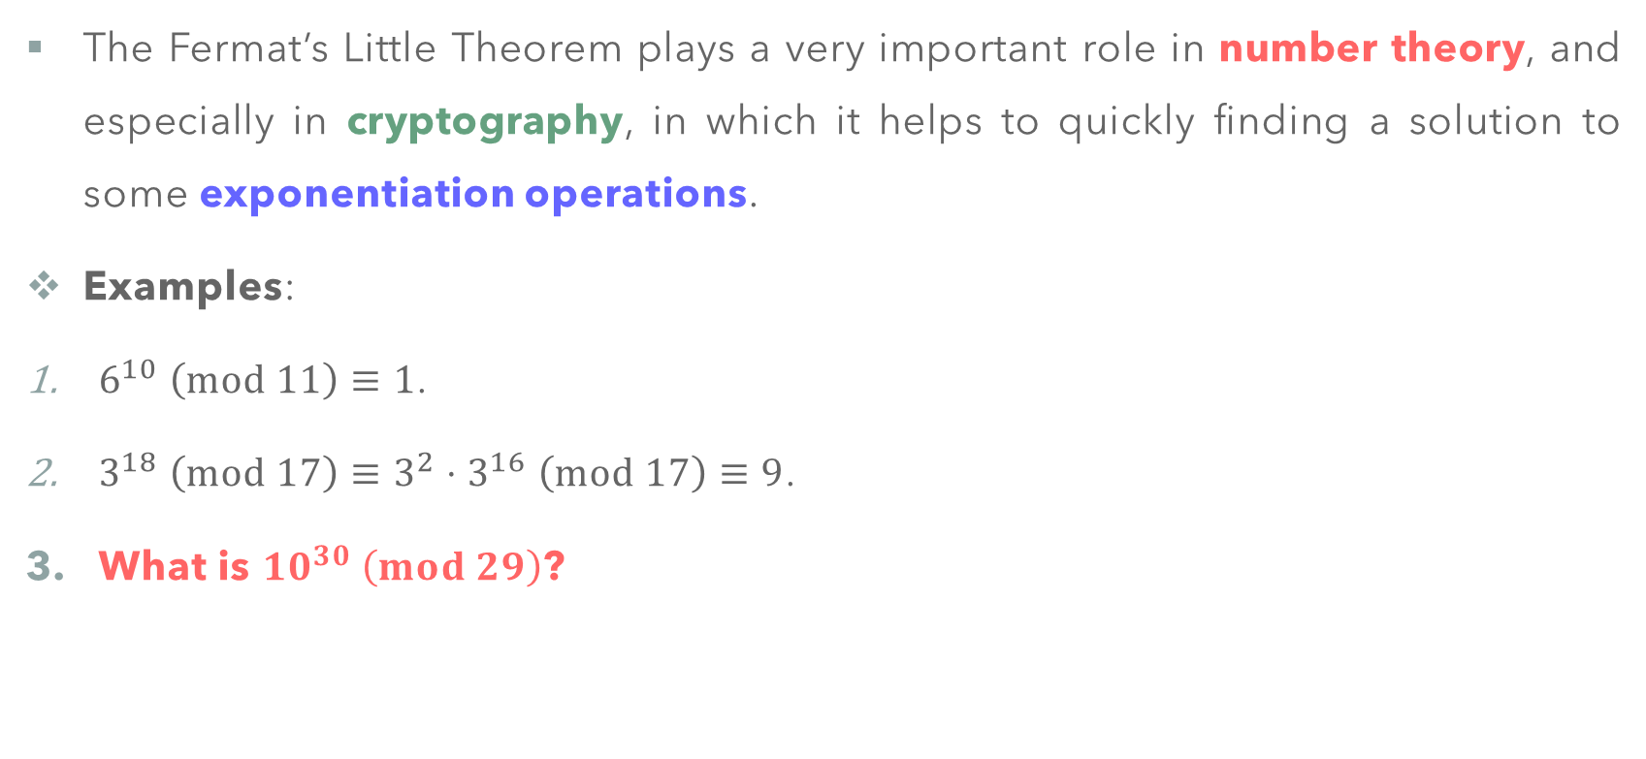
Fermat’s Little Theorem
The Fermat’s Little Theorem plays a very important role in number theory, and especially in cryptography, in which it helps to quickly finding a solution to some exponentiation operations.
Examples:
$6^{10} \left(mod 11\right)≡1$.
$3^{18} \left(mod 17\right)≡3^{2}⋅3^{16} \left(mod 17\right)≡9$.
What is ${10}^{30} \left(mod 29\right)$?

Slide 19
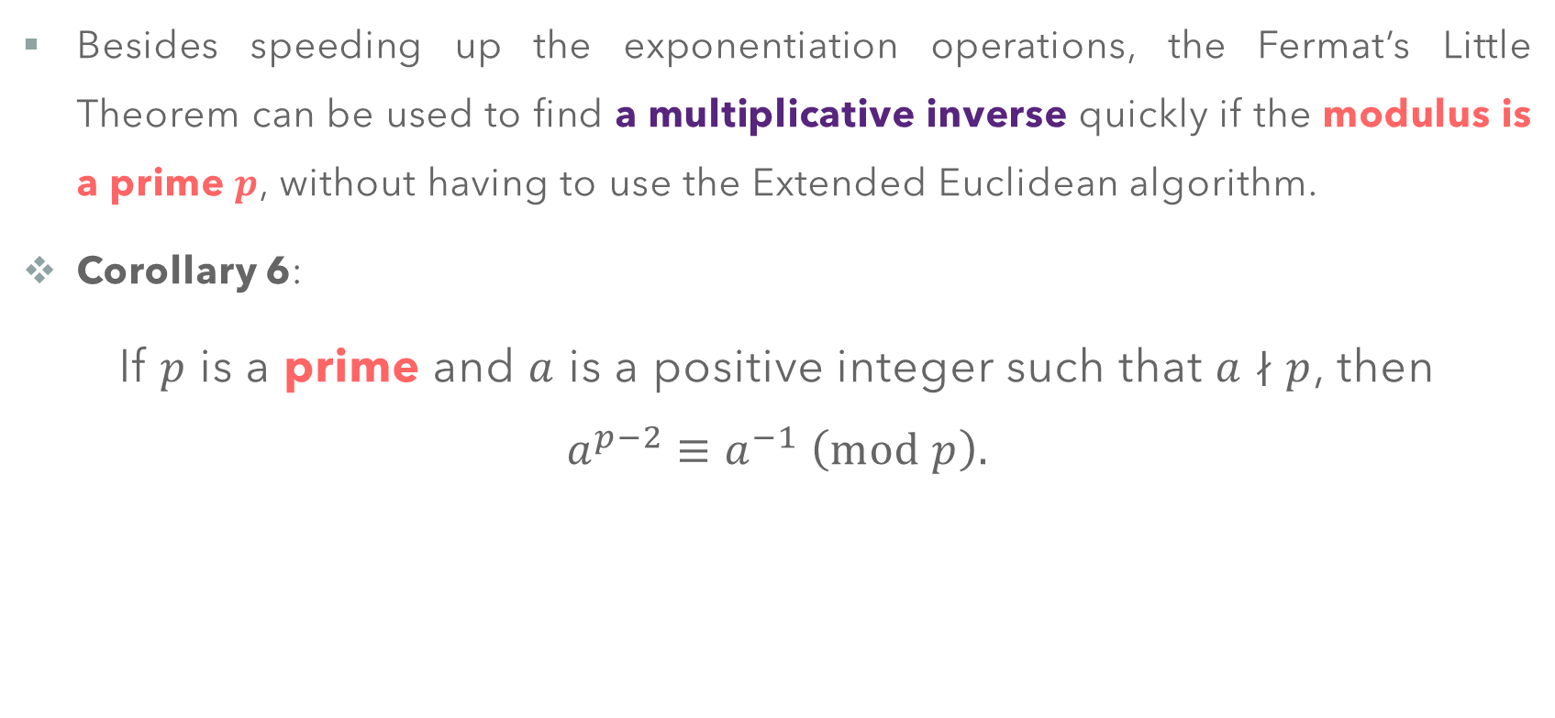
Fermat’s Little Theorem
Besides speeding up the exponentiation operations, the Fermat’s Little Theorem can be used to find a multiplicative inverse quickly if the modulus is a prime $p$, without having to use the Extended Euclidean algorithm.
Corollary 6:
If $p$ is a prime and $a$ is a positive integer such that $a∤p$, then
$$a^{p−2}≡a^{−1} \left(mod p\right).$$

Slide 20
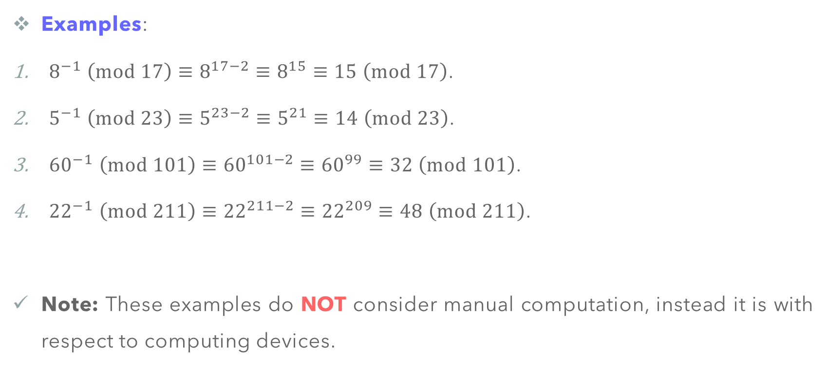
Fermat’s Little Theorem
Examples:
$8^{−1} \left(mod 17\right)≡8^{17−2}≡8^{15}≡15 \left(mod 17\right)$.
$5^{−1} \left(mod 23\right)≡5^{23−2}≡5^{21}≡14 \left(mod 23\right)$.
${60}^{−1} \left(mod 101\right)≡{60}^{101−2}≡{60}^{99}≡32 \left(mod 101\right)$.
${22}^{−1} \left(mod 211\right)≡{22}^{211−2}≡{22}^{209}≡48 \left(mod 211\right)$.
Note: These examples do NOT consider manual computation, instead it is with respect to computing devices.

Slide 21
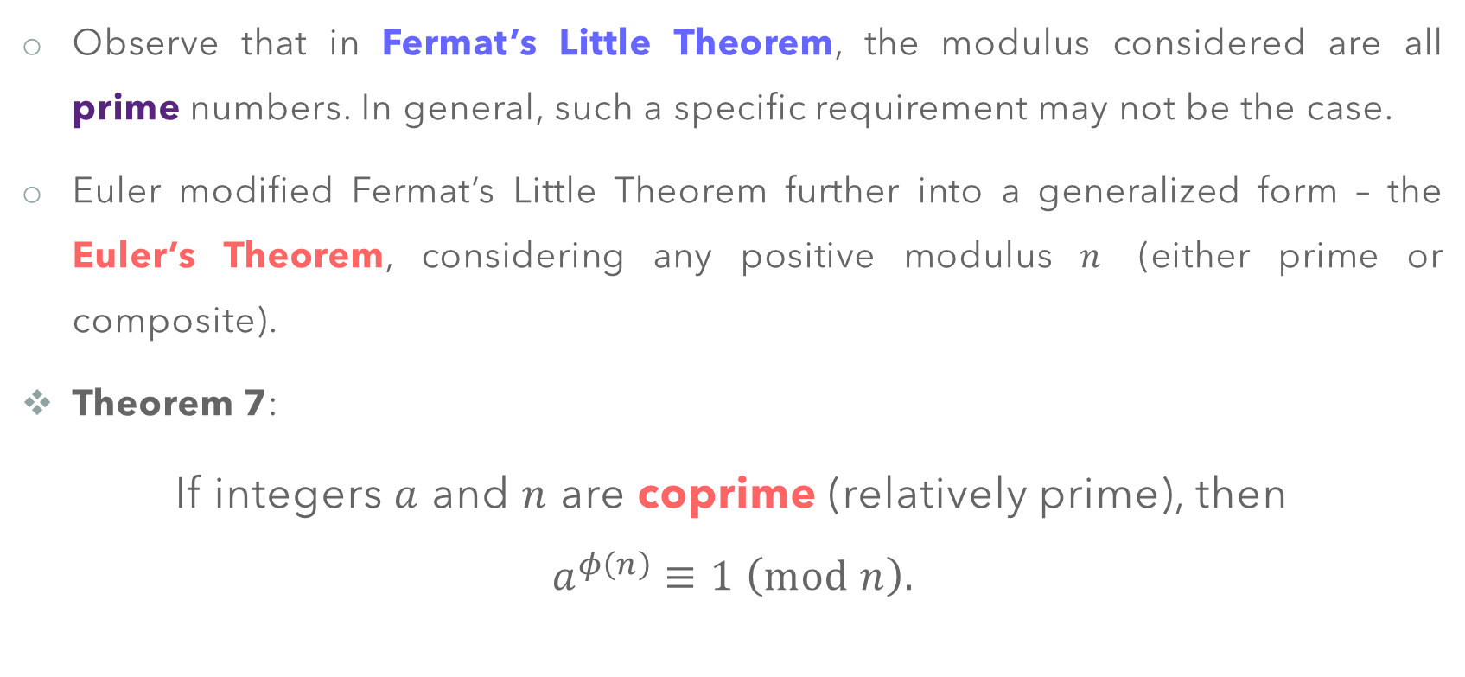
Euler’s Theorem
Observe that in Fermat’s Little Theorem, the modulus considered are all prime numbers. In general, such a specific requirement may not be the case.
Euler modified Fermat’s Little Theorem further into a generalized form – the Euler’s Theorem, considering any positive modulus $n$ (either prime or composite).
Theorem 7:
If integers $a$ and $n$ are coprime (relatively prime), then
$$a^{φ\left(n\right)}≡1 \left(mod n\right).$$

Slide 22
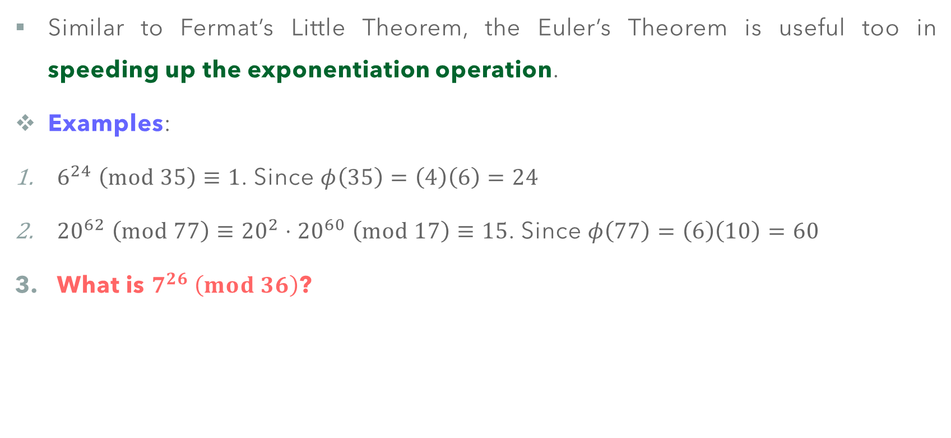
Euler’s Theorem
Similar to Fermat’s Little Theorem, the Euler’s Theorem is useful too in speeding up the exponentiation operation.
Examples:
$6^{24} \left(mod 35\right)≡1$. Since $φ\left(35\right)=\left(4\right)\left(6\right)=24$
${20}^{62} \left(mod 77\right)≡{20}^{2}⋅{20}^{60} \left(mod 17\right)≡15$. Since $φ\left(77\right)=\left(6\right)\left(10\right)=60$
What is $7^{26} \left(mod 36\right)$?

Slide 23
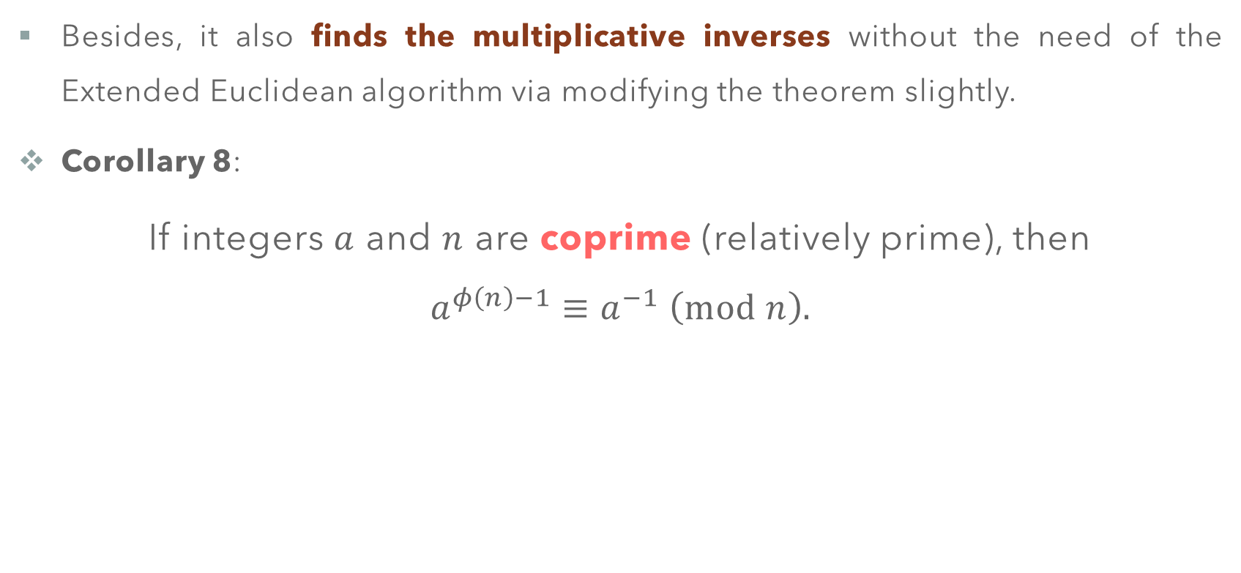
Euler’s Theorem
Besides, it also finds the multiplicative inverses without the need of the Extended Euclidean algorithm via modifying the theorem slightly.
Corollary 8:
If integers $a$ and $n$ are coprime (relatively prime), then
$$a^{φ\left(n\right)−1}≡a^{−1} \left(mod n\right).$$

Slide 24
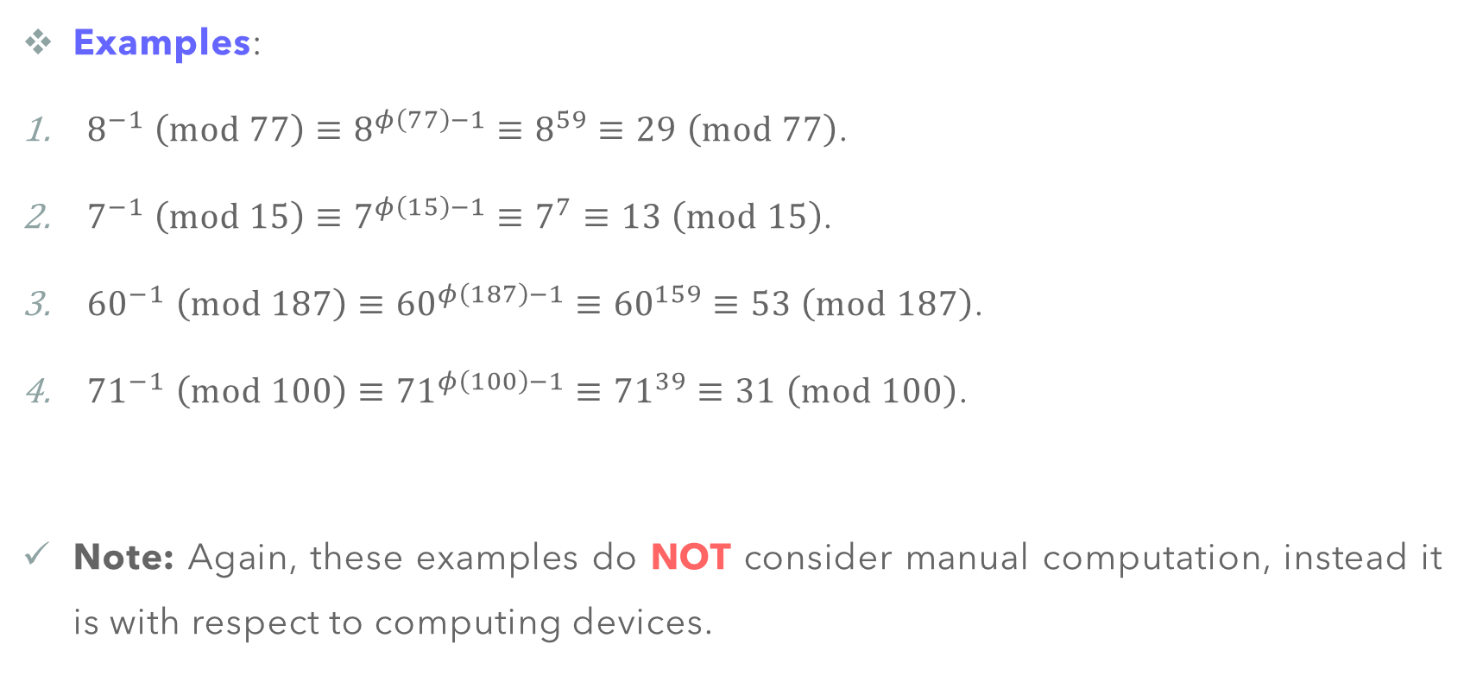
Euler’s Theorem
Examples:
$8^{−1} \left(mod 77\right)≡8^{φ\left(77\right)−1}≡8^{59}≡29 \left(mod 77\right)$.
$7^{−1} \left(mod 15\right)≡7^{φ\left(15\right)−1}≡7^{7}≡13 \left(mod 15\right)$.
${60}^{−1} \left(mod 187\right)≡{60}^{φ\left(187\right)−1}≡{60}^{159}≡53 \left(mod 187\right)$.
${71}^{−1} \left(mod 100\right)≡{71}^{φ\left(100\right)−1}≡{71}^{39}≡31 \left(mod 100\right)$.
Note: Again, these examples do NOT consider manual computation, instead it is with respect to computing devices.

Slide 25
PRIME NUMBERS AND PRIMALITY TESTING

Slide 26
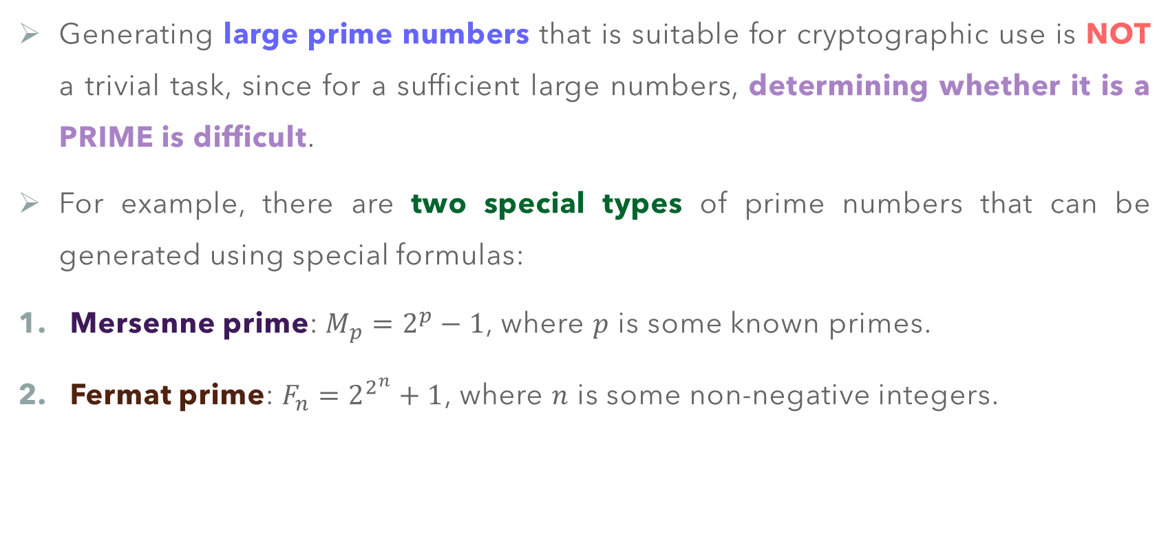
Prime Numbers
Generating large prime numbers that is suitable for cryptographic use is NOT a trivial task, since for a sufficient large numbers, determining whether it is a PRIME is difficult.
For example, there are two special types of prime numbers that can be generated using special formulas:
Mersenne prime: $M_{p}=2^{p}−1$, where $p$ is some known primes.
Fermat prime: $F_{n}=2^{2^{n}}+1$, where $n$ is some non-negative integers.

Slide 27



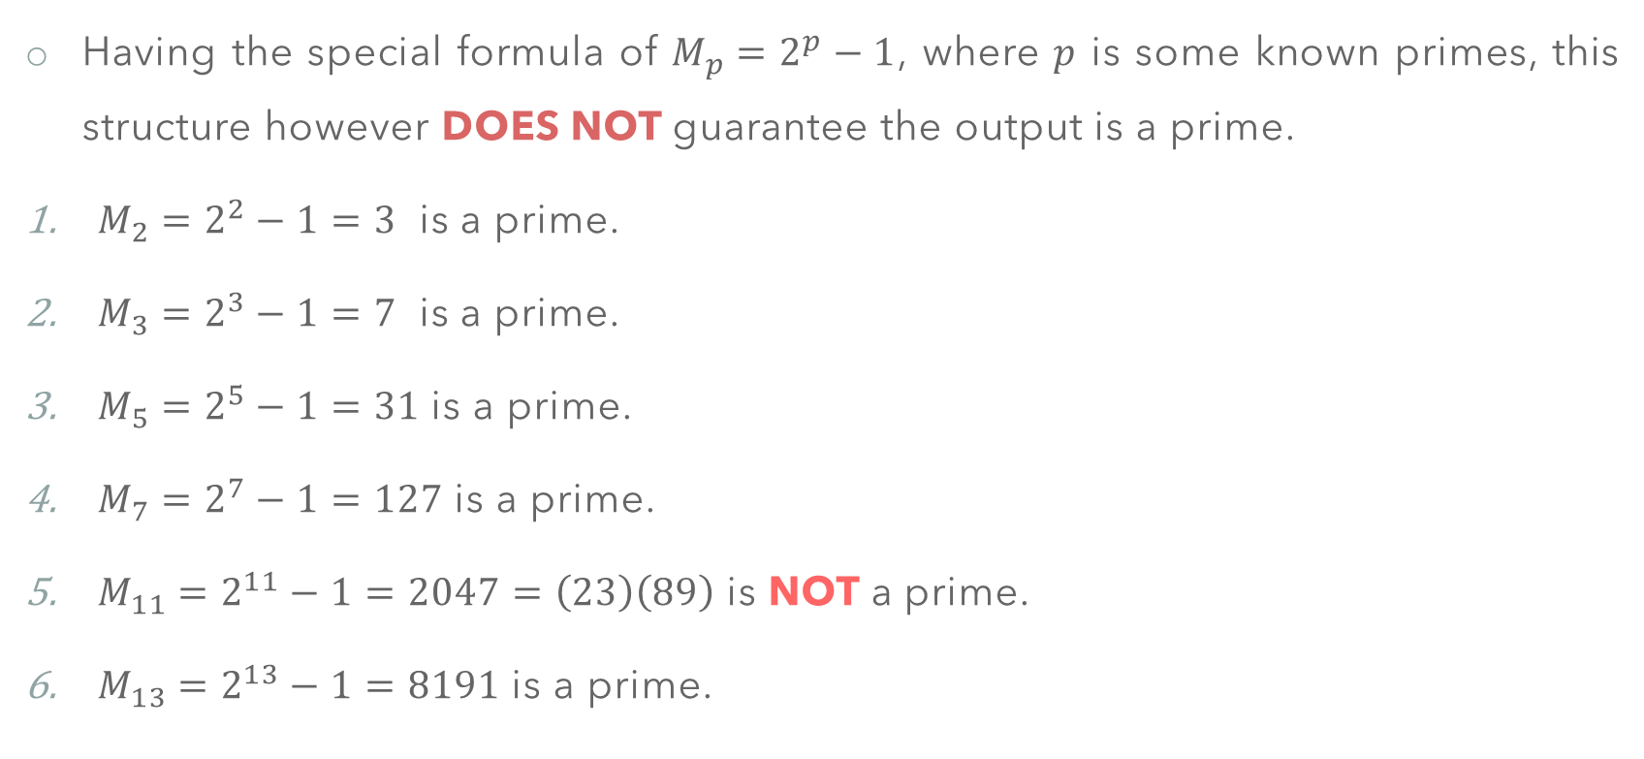
Prime Numbers – Mersenne Primes
Having the special formula of $M_{p}=2^{p}−1$, where $p$ is some known primes, this structure however DOES NOT guarantee the output is a prime.
$M_{2}=2^{2}−1=3$ is a prime.
$M_{3}=2^{3}−1=7$ is a prime.
$M_{5}=2^{5}−1=31$ is a prime.
$M_{7}=2^{7}−1=127$ is a prime.
$M_{11}=2^{11}−1=2047=\left(23\right)\left(89\right)$ is NOT a prime.
$M_{13}=2^{13}−1=8191$ is a prime.

Slide 28
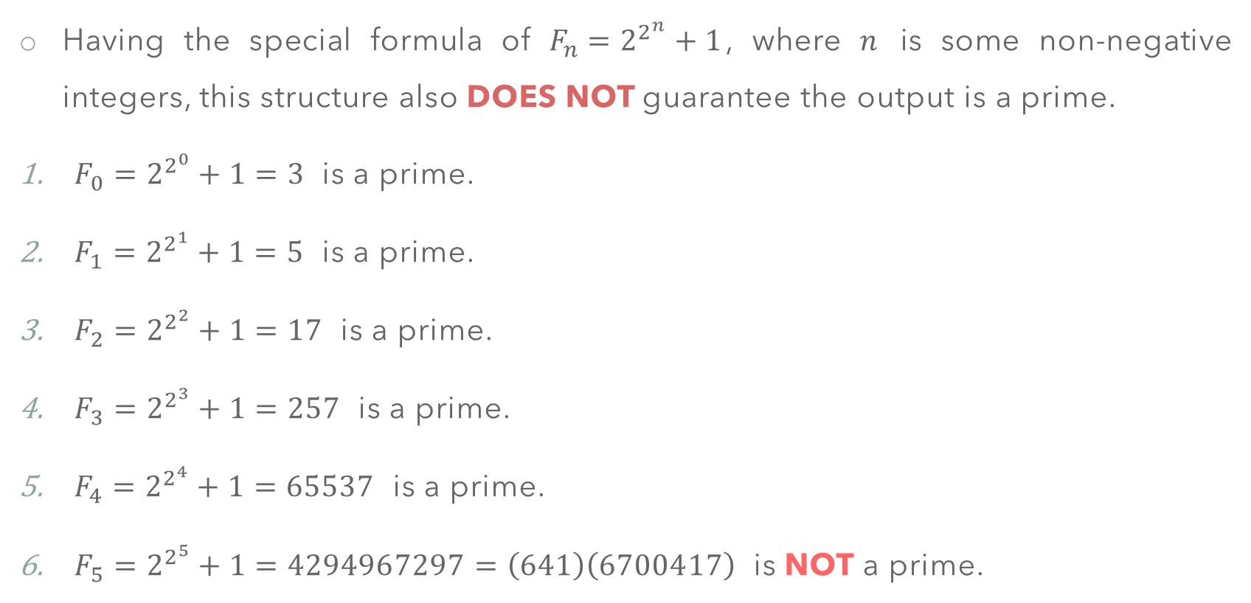
Prime Numbers – Fermat Primes
Having the special formula of $F_{n}=2^{2^{n}}+1$, where $n$ is some non-negative integers, this structure also DOES NOT guarantee the output is a prime.
$F_{0}=2^{2^{0}}+1=3$ is a prime.
$F_{1}=2^{2^{1}}+1=5$ is a prime.
$F_{2}=2^{2^{2}}+1=17$ is a prime.
$F_{3}=2^{2^{3}}+1=257$ is a prime.
$F_{4}=2^{2^{4}}+1=65537$ is a prime.
$F_{5}=2^{2^{5}}+1=4294967297=\left(641\right)\left(6700417\right)$ is NOT a prime.

Slide 29
Prime Numbers and Primality Testing
There are several methods that can be used to test whether a given number is a prime, or composite, that categorized into two major branches.
Deterministic Algorithms: Algorithms that accept and integer and always output either PRIME, or COMPOSITE.
Sieve of Eratosthenes
Divisibility Algorithm
AKS Algorithm
Probabilistic Algorithms: Algorithms that DO NOT guarantee the correctness of the result.
Fermat Primality Test
Miller-Rabin Test

Slide 30
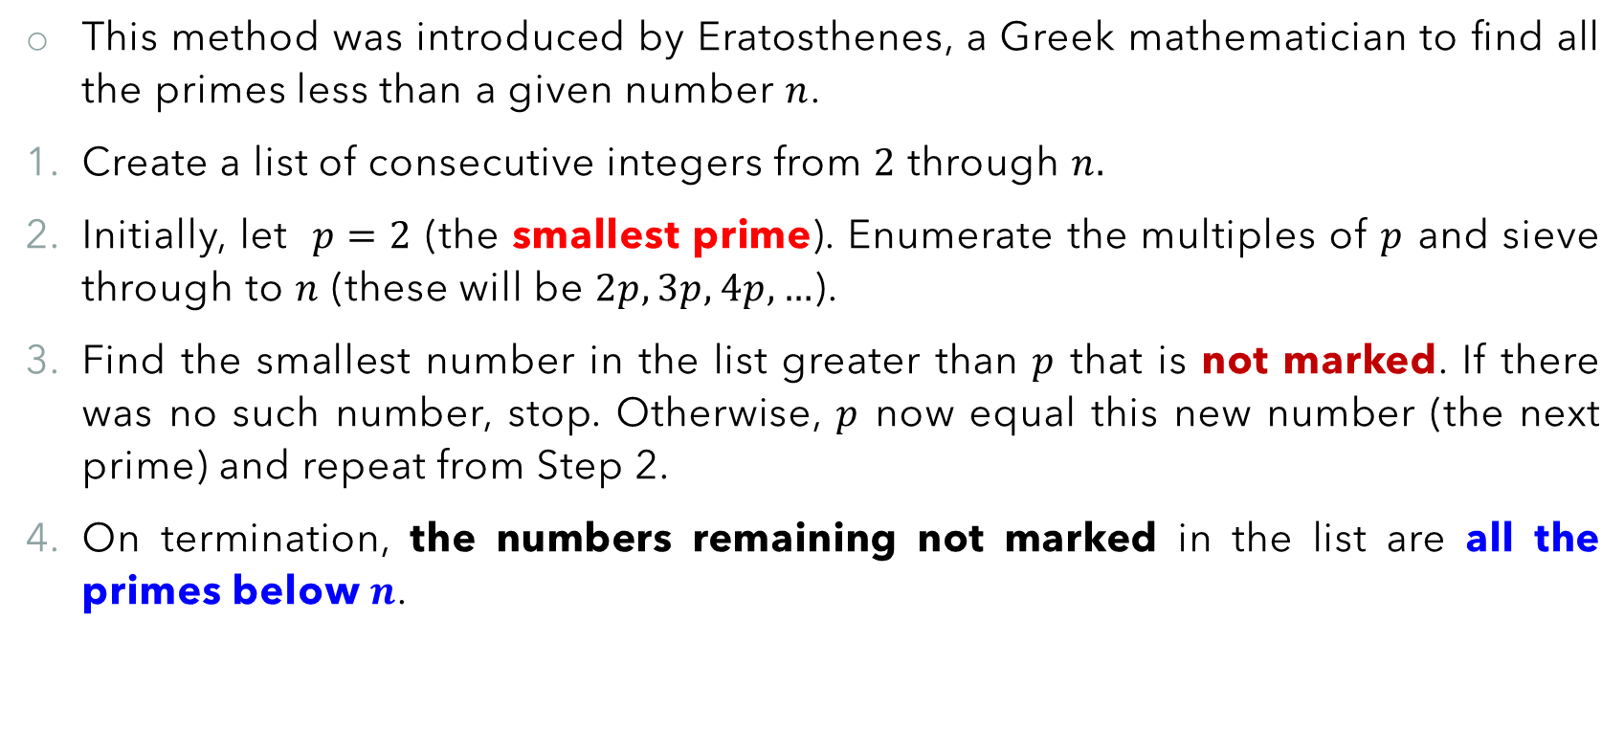
Deterministic Algorithms – Sieve of Eratosthenes
This method was introduced by Eratosthenes, a Greek mathematician to find all the primes less than a given number $n$.
Create a list of consecutive integers from $2$ through $n.$
Initially, let $p=2$ (the smallest prime). Enumerate the multiples of $p$ and sieve through to $n$ (these will be $2p,3p,4p,…$).
Find the smallest number in the list greater than $p$ that is not marked. If there was no such number, stop. Otherwise, $p$ now equal this new number (the next prime) and repeat from Step 2.
On termination, the numbers remaining not marked in the list are all the primes below $n$.

Slide 31
Deterministic Algorithms – Sieve of Eratosthenes
Example 1: The primes between 1 and 100 through the sieve of Eratosthenes.
1 | 2 | 3 | 4 | 5 | 6 | 7 | 8 | 9 | 10
11 | 12 | 13 | 14 | 15 | 16 | 17 | 18 | 19 | 20
21 | 22 | 23 | 24 | 25 | 26 | 27 | 28 | 29 | 30
31 | 32 | 33 | 34 | 35 | 36 | 37 | 38 | 39 | 40
41 | 42 | 43 | 44 | 45 | 46 | 47 | 48 | 49 | 50
51 | 52 | 53 | 54 | 55 | 56 | 57 | 58 | 59 | 60
61 | 62 | 63 | 64 | 65 | 66 | 67 | 68 | 69 | 70
71 | 72 | 73 | 74 | 75 | 76 | 77 | 78 | 79 | 80
81 | 82 | 83 | 84 | 85 | 86 | 87 | 88 | 89 | 90
91 | 92 | 93 | 94 | 95 | 96 | 97 | 98 | 99 | 100

Slide 32

Deterministic Algorithms – Sieve of Eratosthenes
Example 1: The primes between 1 and 100 through the sieve of Eratosthenes.
1 | 2 | 3 | 4 | 5 | 6 | 7 | 8 | 9 | 10
11 | 12 | 13 | 14 | 15 | 16 | 17 | 18 | 19 | 20
21 | 22 | 23 | 24 | 25 | 26 | 27 | 28 | 29 | 30
31 | 32 | 33 | 34 | 35 | 36 | 37 | 38 | 39 | 40
41 | 42 | 43 | 44 | 45 | 46 | 47 | 48 | 49 | 50
51 | 52 | 53 | 54 | 55 | 56 | 57 | 58 | 59 | 60
61 | 62 | 63 | 64 | 65 | 66 | 67 | 68 | 69 | 70
71 | 72 | 73 | 74 | 75 | 76 | 77 | 78 | 79 | 80
81 | 82 | 83 | 84 | 85 | 86 | 87 | 88 | 89 | 90
91 | 92 | 93 | 94 | 95 | 96 | 97 | 98 | 99 | 100

Slide 33
Deterministic Algorithms – Sieve of Eratosthenes
Exercise 1: Determine the primes between 101 and 150 through the sieve of Eratosthenes.
101 | 102 | 103 | 104 | 105 | 106 | 107 | 108 | 109 | 110
111 | 112 | 113 | 114 | 115 | 116 | 117 | 118 | 119 | 120
121 | 122 | 123 | 124 | 125 | 126 | 127 | 128 | 129 | 130
131 | 132 | 133 | 134 | 135 | 136 | 137 | 138 | 139 | 140
141 | 142 | 143 | 144 | 145 | 146 | 147 | 148 | 149 | 150

Slide 34
Deterministic Algorithms – Sieve of Eratosthenes
Exercise 1: Determine the primes between 101 and 150 through the sieve of Eratosthenes.
101 | 102 | 103 | 104 | 105 | 106 | 107 | 108 | 109 | 110
111 | 112 | 113 | 114 | 115 | 116 | 117 | 118 | 119 | 120
121 | 122 | 123 | 124 | 125 | 126 | 127 | 128 | 129 | 130
131 | 132 | 133 | 134 | 135 | 136 | 137 | 138 | 139 | 140
141 | 142 | 143 | 144 | 145 | 146 | 147 | 148 | 149 | 150

Slide 35
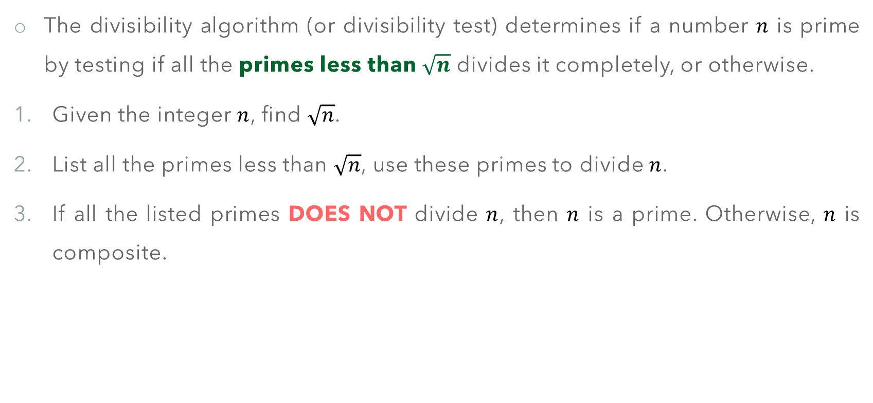
Deterministic Algorithms – Divisibility Algorithm
The divisibility algorithm (or divisibility test) determines if a number $n$ is prime by testing if all the primes less than $\sqrt{n}$ divides it completely, or otherwise.
Given the integer $n$, find $\sqrt{n}$.
List all the primes less than $\sqrt{n}$, use these primes to divide $n$.
If all the listed primes DOES NOT divide $n$, then $n$ is a prime. Otherwise, $n$ is composite.

Slide 36

Deterministic Algorithms – Divisibility Algorithm
The bit-operation complexity of the divisibility algorithm is exponential. That is, given an $n_{b}$-bit integer, the algorithm runs at $𝒪\left(2^{\frac{n_{b}}{2}}\right)$ complexity.

Slide 37
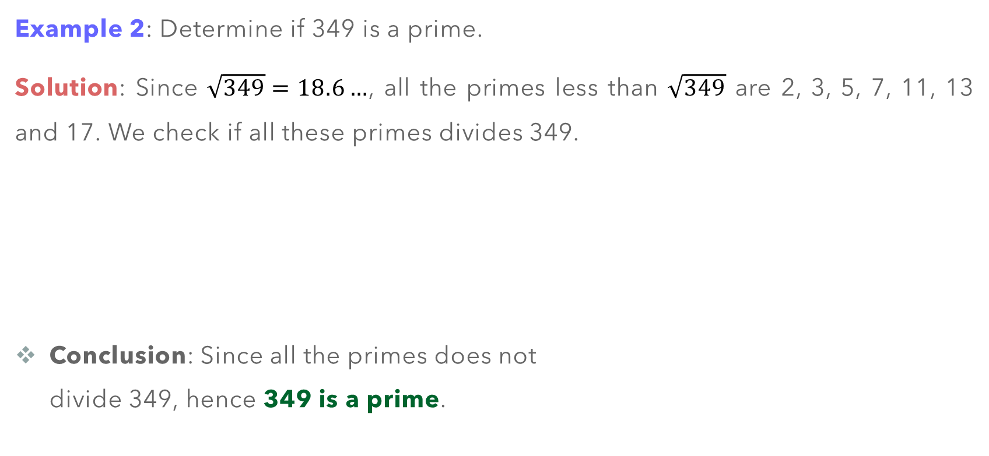
Deterministic Algorithms – Divisibility Algorithm
Example 2: Determine if 349 is a prime.
Solution: Since $\sqrt{349}=18.6…$, all the primes less than $\sqrt{349}$ are 2, 3, 5, 7, 11, 13 and 17. We check if all these primes divides 349.
Conclusion: Since all the primes does not divide 349, hence 349 is a prime.
Primes | Does it divides 349
2 | No
3 | No
5 | No
7 | No
11 | No
13 | No
17 | No

Slide 38
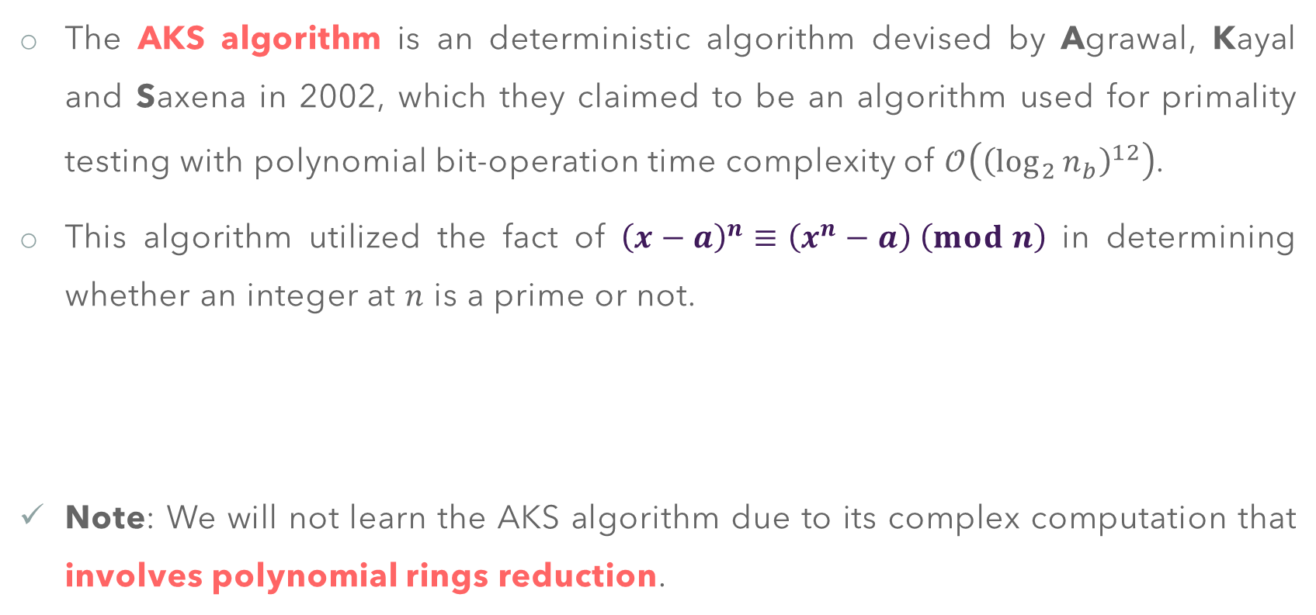
Deterministic Algorithms – AKS Algorithm
The AKS algorithm is an deterministic algorithm devised by Agrawal, Kayal and Saxena in 2002, which they claimed to be an algorithm used for primality testing with polynomial bit-operation time complexity of $𝒪\left({\left(\log_{2}{n_{b}}\right)}^{12}\right)$.
This algorithm utilized the fact of ${\left(x−a\right)}^{n}≡\left(x^{n}−a\right) \left(mod n\right)$ in determining whether an integer at $n$ is a prime or not.
Note: We will not learn the AKS algorithm due to its complex computation that involves polynomial rings reduction.

Slide 39
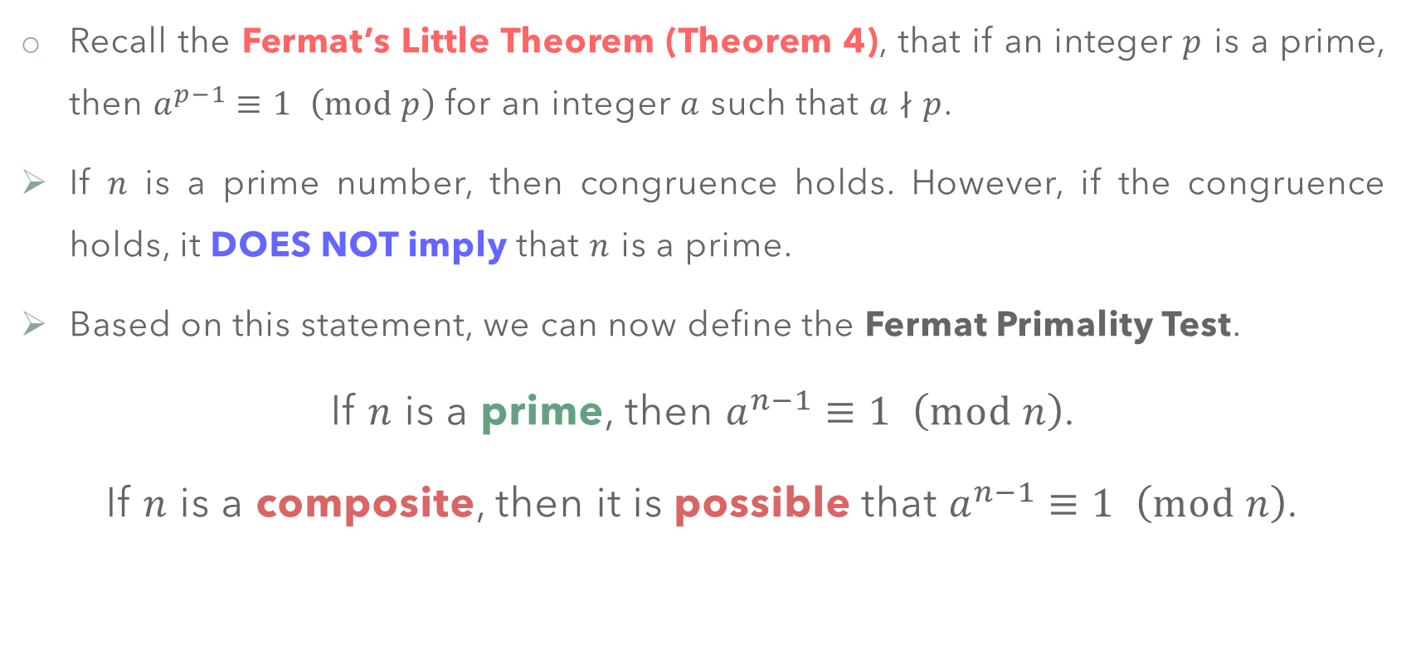
Probabilistic Algorithms – Fermat Primality Test
Recall the Fermat’s Little Theorem (Theorem 4), that if an integer $p$ is a prime, then $a^{p−1}≡1 \left(mod p\right)$ for an integer $a$ such that $a∤p$.
If $n$ is a prime number, then congruence holds. However, if the congruence holds, it DOES NOT imply that $n$ is a prime.
Based on this statement, we can now define the Fermat Primality Test.
If $n$ is a prime, then $a^{n−1}≡1 \left(mod n\right)$.
If $n$ is a composite, then it is possible that $a^{n−1}≡1 \left(mod n\right)$.

Slide 40
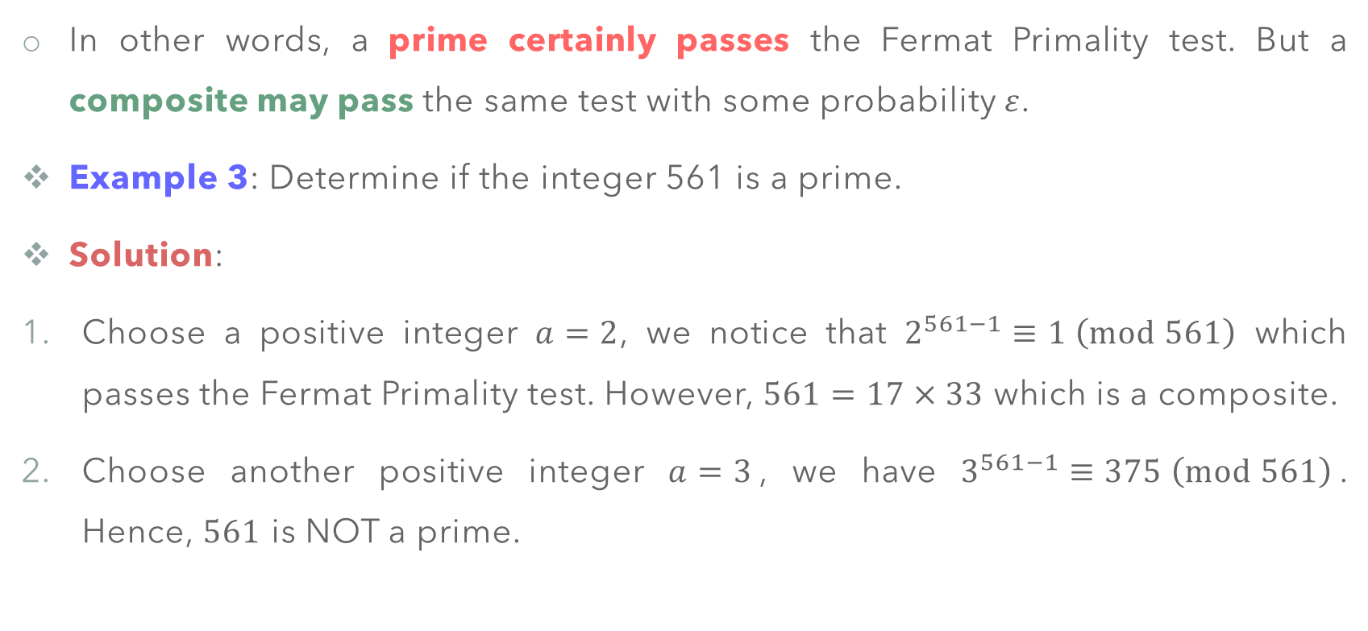
Probabilistic Algorithms – Fermat Primality Test
In other words, a prime certainly passes the Fermat Primality test. But a composite may pass the same test with some probability $ε$.
Example 3: Determine if the integer 561 is a prime.
Solution:
Choose a positive integer $a=2$, we notice that $2^{561−1}≡1 \left(mod 561\right)$ which passes the Fermat Primality test. However, $561=17×33$ which is a composite.
Choose another positive integer $a=3$, we have $3^{561−1}≡375 \left(mod 561\right)$. Hence, $561$ is NOT a prime.

Slide 41
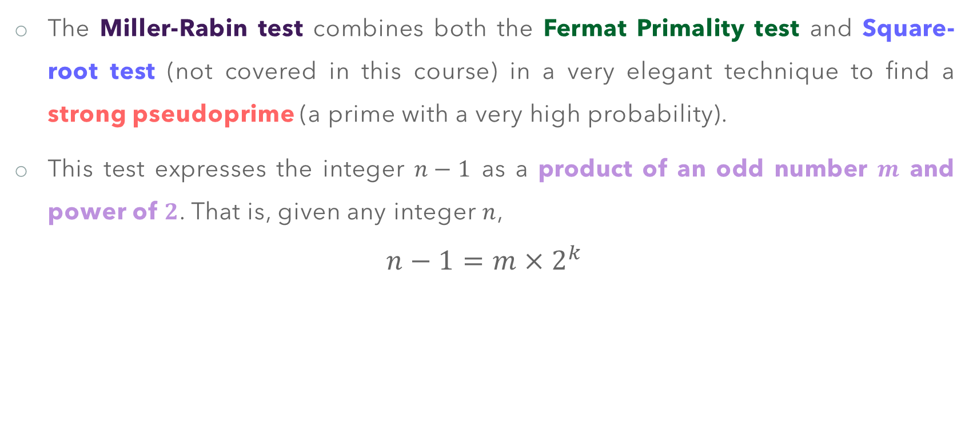
Probabilistic Algorithms – Miller–Rabin Test
The Miller-Rabin test combines both the Fermat Primality test and Square-root test (not covered in this course) in a very elegant technique to find a strong pseudoprime (a prime with a very high probability).
This test expresses the integer $n−1$ as a product of an odd number $m$ and power of $2$. That is, given any integer $n$,
$$n−1=m×2^{k}$$

Slide 42
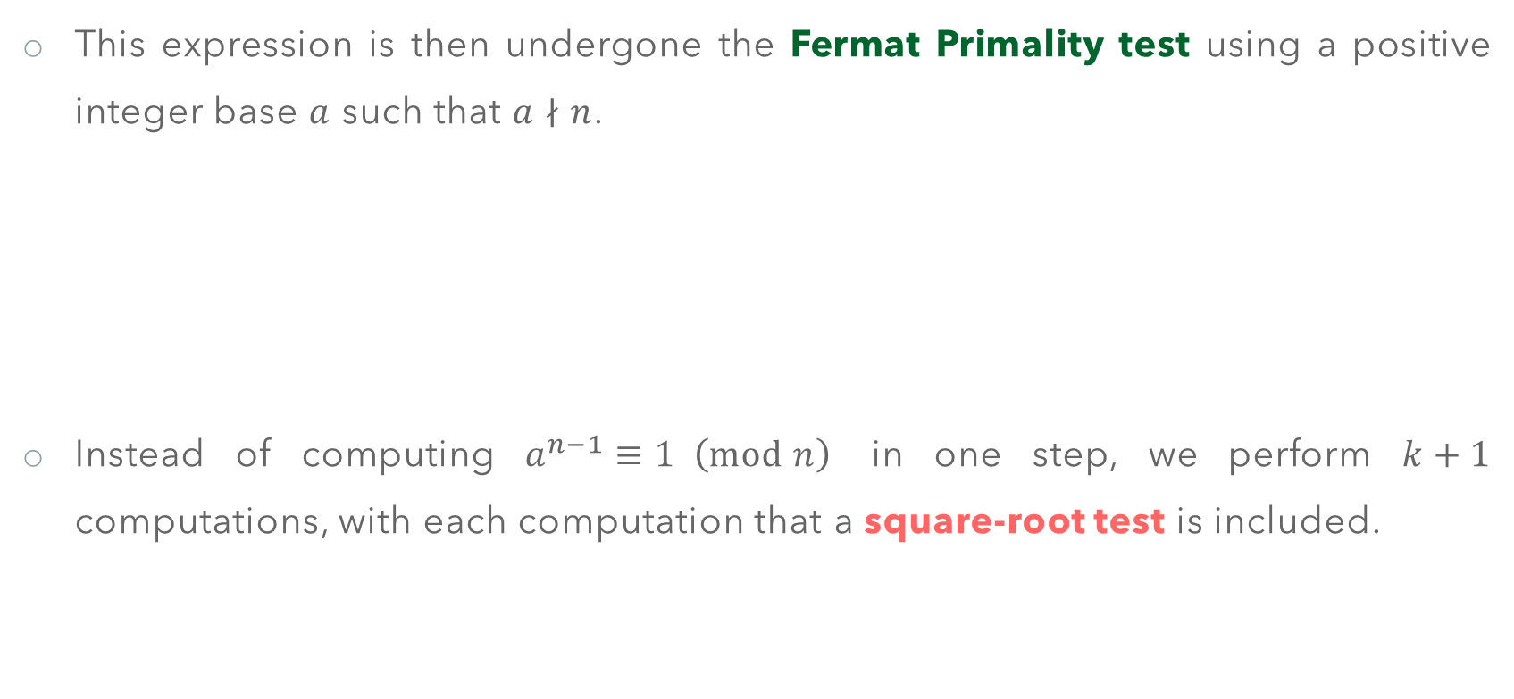
Probabilistic Algorithms – Miller–Rabin Test
This expression is then undergone the Fermat Primality test using a positive integer base $a$ such that $a∤n$.
Instead of computing $a^{n−1}≡1 \left(mod n\right)$ in one step, we perform $k+1$ computations, with each computation that a square-root test is included.

Slide 43
Probabilistic Algorithms – Miller–Rabin Test

Slide 44
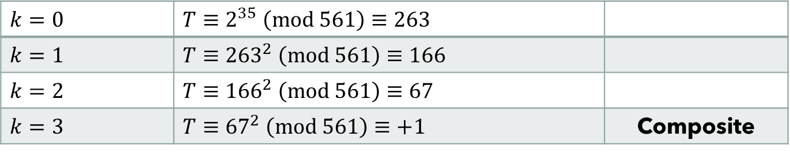
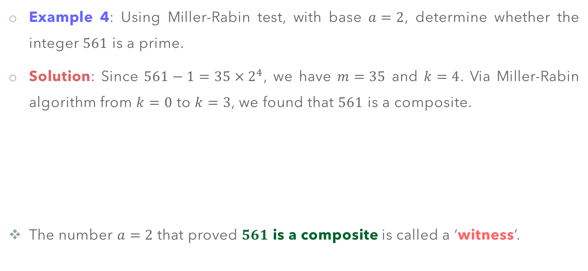
Probabilistic Algorithms – Miller–Rabin Test
Example 4: Using Miller-Rabin test, with base $a=2$, determine whether the integer $561$ is a prime.
Solution: Since $561−1=35×2^{4}$, we have $m=35$ and $k=4$. Via Miller-Rabin algorithm from $k=0$ to $k=3$, we found that $561$ is a composite.
The number $a=2$ that proved $561$ is a composite is called a ‘witness’.
$k=0$ | $T≡2^{35} \left(mod 561\right)≡263$
$k=1$ | $T≡{263}^{2} \left(mod 561\right)≡166$
$k=2$ | $T≡{166}^{2} \left(mod 561\right)≡67$
$k=3$ | $T≡{67}^{2} \left(mod 561\right)≡+1$ | Composite

Slide 45
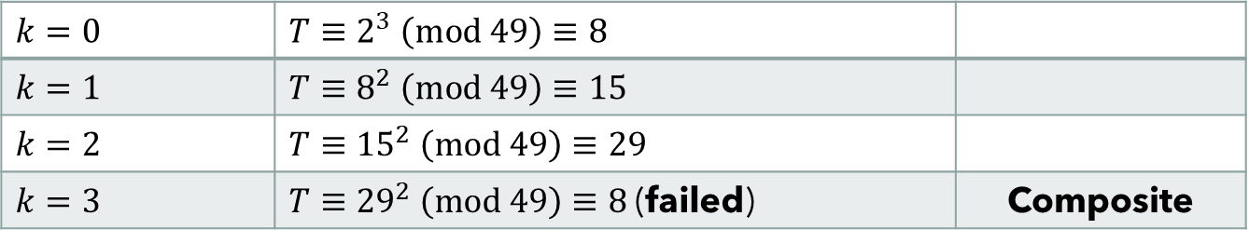
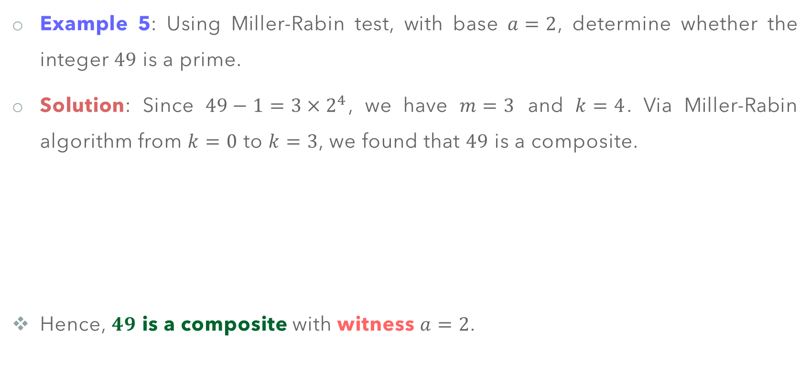
Probabilistic Algorithms – Miller–Rabin Test
Example 5: Using Miller-Rabin test, with base $a=2$, determine whether the integer $49$ is a prime.
Solution: Since $49−1=3×2^{4}$, we have $m=3$ and $k=4$. Via Miller-Rabin algorithm from $k=0$ to $k=3$, we found that $49$ is a composite.
Hence, $49$ is a composite with witness $a=2$.
$k=0$ | $T≡2^{3} \left(mod 49\right)≡8$
$k=1$ | $T≡8^{2} \left(mod 49\right)≡15$
$k=2$ | $T≡{15}^{2} \left(mod 49\right)≡29$
$k=3$ | $T≡{29}^{2} \left(mod 49\right)≡8$ (failed) | Composite

Slide 46
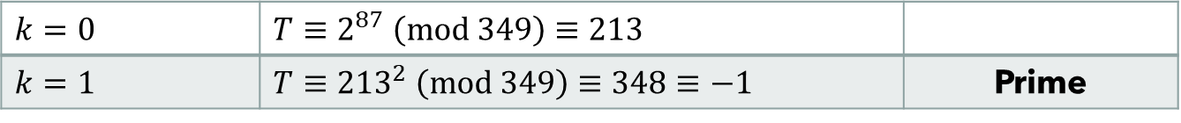
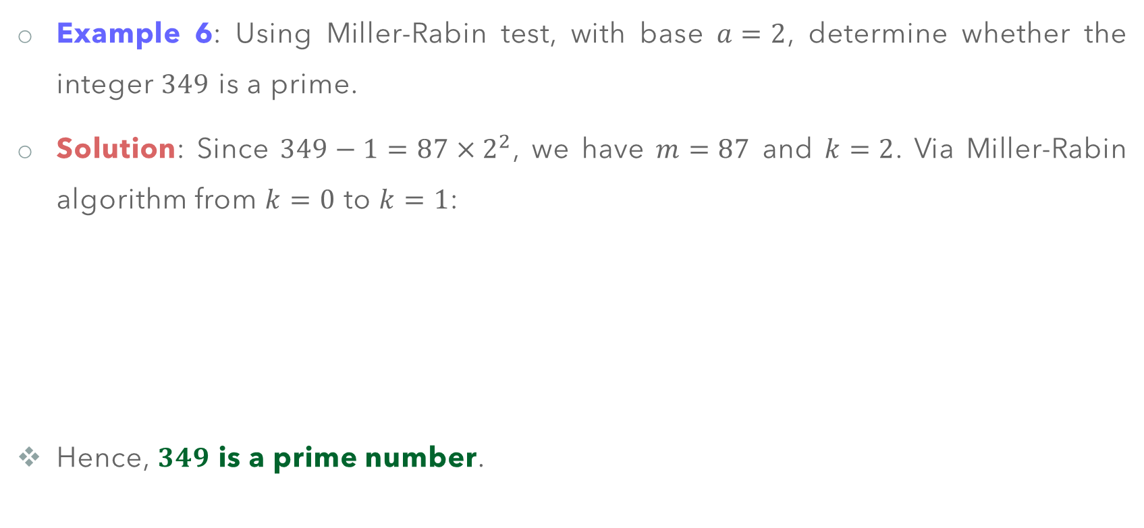
Probabilistic Algorithms – Miller–Rabin Test
Example 6: Using Miller-Rabin test, with base $a=2$, determine whether the integer $349$ is a prime.
Solution: Since $349−1=87×2^{2}$, we have $m=87$ and $k=2$. Via Miller-Rabin algorithm from $k=0$ to $k=1$:
Hence, $349$ is a prime number.
$k=0$ | $T≡2^{87} \left(mod 349\right)≡213$
$k=1$ | $T≡{213}^{2} \left(mod 349\right)≡348≡−1$ | Prime

Slide 47
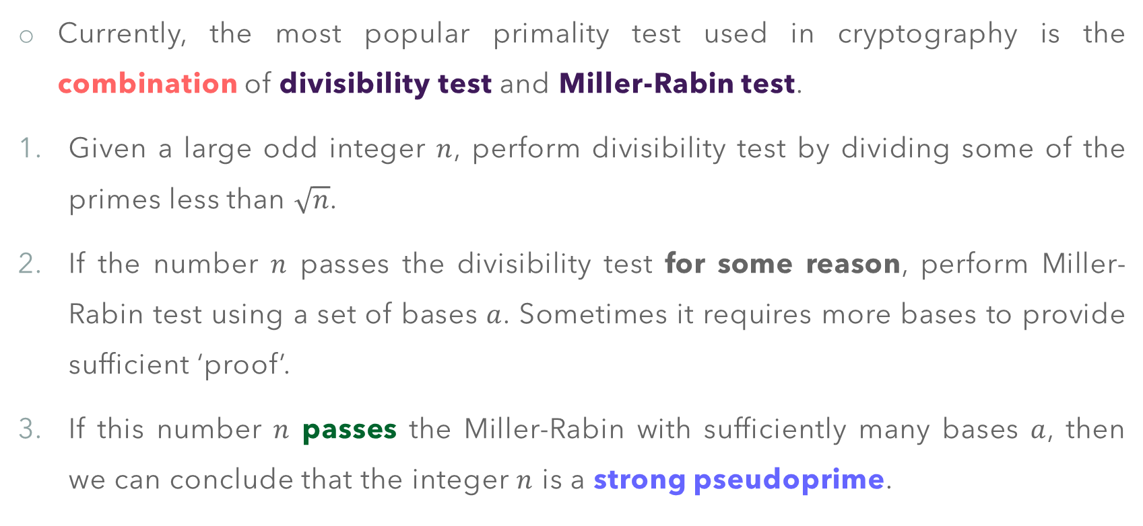
Primality Testing – The Recommended Test
Currently, the most popular primality test used in cryptography is the combination of divisibility test and Miller-Rabin test.
Given a large odd integer $n$, perform divisibility test by dividing some of the primes less than $\sqrt{n}$.
If the number $n$ passes the divisibility test for some reason, perform Miller-Rabin test using a set of bases $a$. Sometimes it requires more bases to provide sufficient ‘proof’.
If this number $n$ passes the Miller-Rabin with sufficiently many bases $a$, then we can conclude that the integer $n$ is a strong pseudoprime.

Slide 48
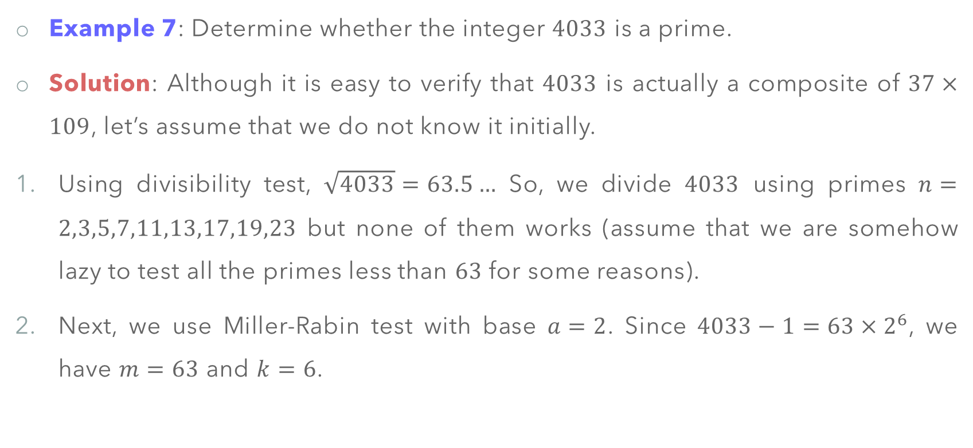
Primality Testing – The Recommended Test
Example 7: Determine whether the integer $4033$ is a prime.
Solution: Although it is easy to verify that $4033$ is actually a composite of $37×109$, let’s assume that we do not know it initially.
Using divisibility test, $\sqrt{4033}=63.5…$ So, we divide $4033$ using primes $n=2,3,5,7,11,13,17,19,23$ but none of them works (assume that we are somehow lazy to test all the primes less than $63$ for some reasons).
Next, we use Miller-Rabin test with base $a=2$. Since $4033−1=63×2^{6}$, we have $m=63$ and $k=6$.

Slide 49

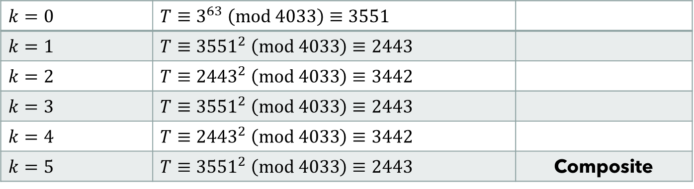
Primality Testing – The Recommended Test
The first base $a=2$ tells us it is a prime. But let’s say we are NOT satisfied with the result, we choose the next base $a=3$ for the second round of Miller-Rabin test.
$k=0$ | $T≡2^{63} \left(mod 4033\right)≡3521$
$k=1$ | $T≡{3521}^{2} \left(mod 4033\right)≡4032≡−1$ | Pass, but prime?
$k=0$ | $T≡3^{63} \left(mod 4033\right)≡3551$
$k=1$ | $T≡{3551}^{2} \left(mod 4033\right)≡2443$
$k=2$ | $T≡{2443}^{2} \left(mod 4033\right)≡3442$
$k=3$ | $T≡{3551}^{2} \left(mod 4033\right)≡2443$
$k=4$ | $T≡{2443}^{2} \left(mod 4033\right)≡3442$
$k=5$ | $T≡{3551}^{2} \left(mod 4033\right)≡2443$ | Composite

Slide 50
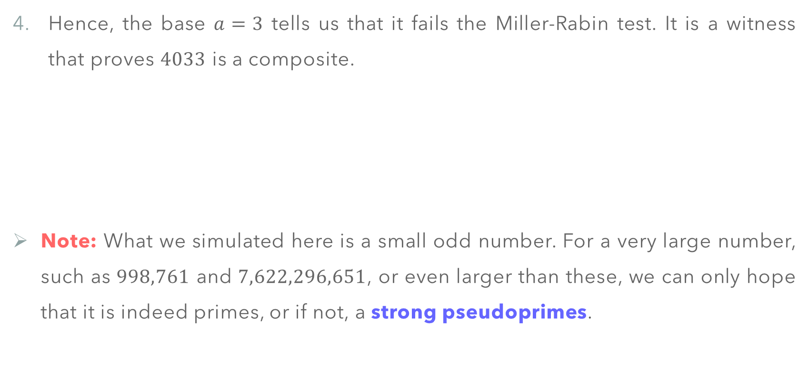
Primality Testing – The Recommended Test
Hence, the base $a=3$ tells us that it fails the Miller-Rabin test. It is a witness that proves $4033$ is a composite.
Note: What we simulated here is a small odd number. For a very large number, such as $998,761$ and $7,622,296,651$, or even larger than these, we can only hope that it is indeed primes, or if not, a strong pseudoprimes.

Slide 51
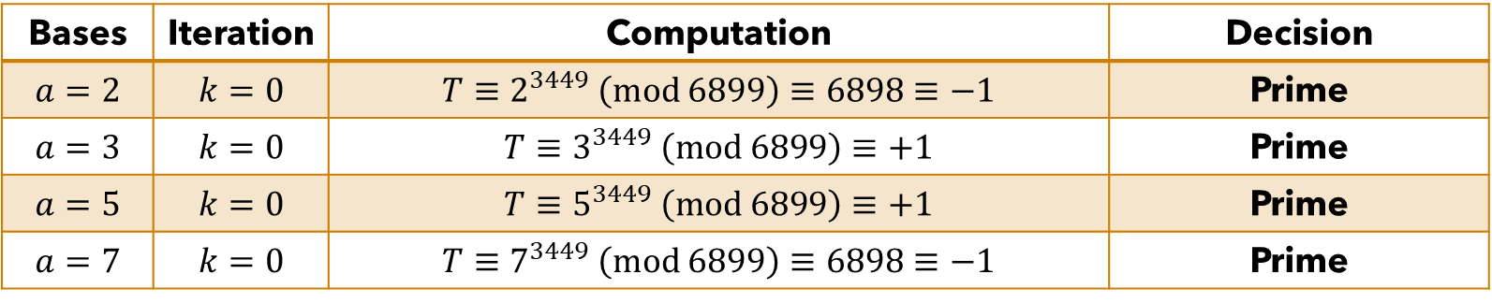
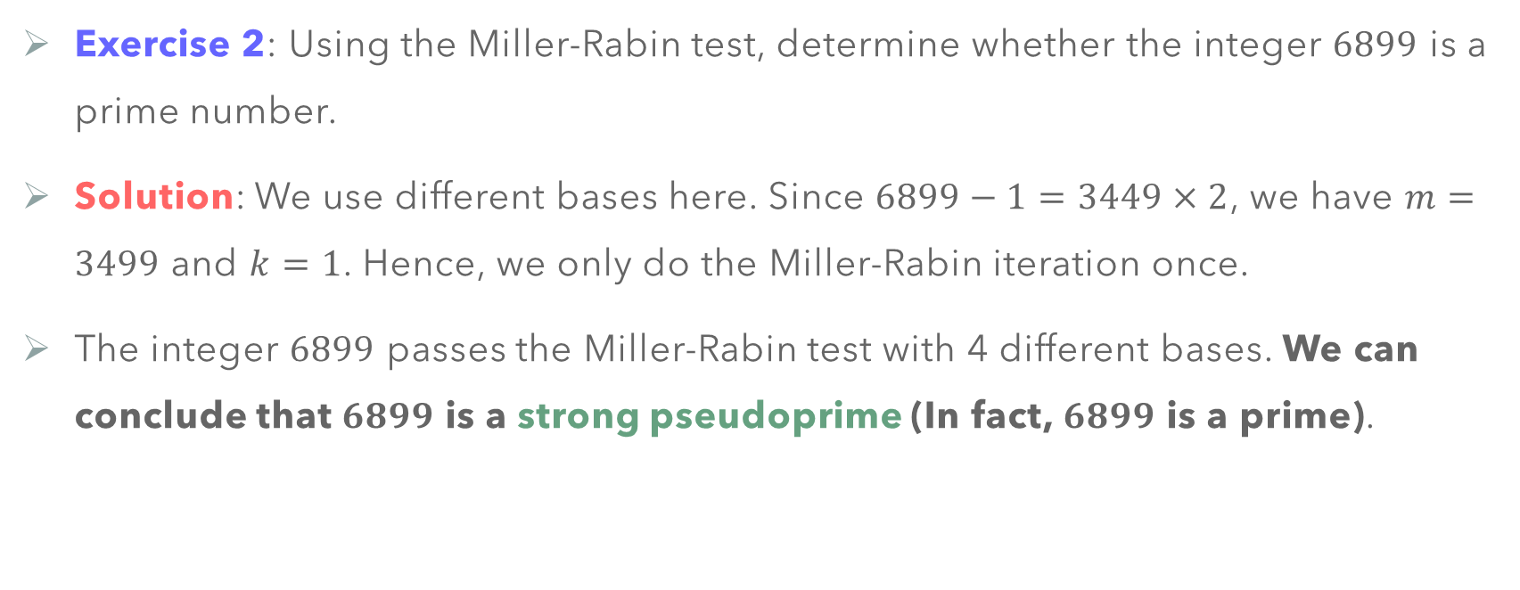
Primality Testing
Exercise 2: Using the Miller-Rabin test, determine whether the integer $6899$ is a prime number.
Solution: We use different bases here. Since $6899−1=3449×2$, we have $m=3499$ and $k=1$. Hence, we only do the Miller-Rabin iteration once.
The integer $6899$ passes the Miller-Rabin test with 4 different bases. We can conclude that $6899$ is a strong pseudoprime (In fact, $6899$ is a prime).
Bases | Iteration | Computation | Decision
$$a=2$$ | $k=0$ | $$T≡2^{3449} \left(mod 6899\right)≡6898≡−1$$ | Prime
$$a=3$$ | $k=0$ | $$T≡3^{3449} \left(mod 6899\right)≡+1$$ | Prime
$$a=5$$ | $k=0$ | $$T≡5^{3449} \left(mod 6899\right)≡+1$$ | Prime
$$a=7$$ | $k=0$ | $$T≡7^{3449} \left(mod 6899\right)≡6898≡−1$$ | Prime

Slide 52
CHINESE REMAINDER THEOREM (Optional)

Slide 53
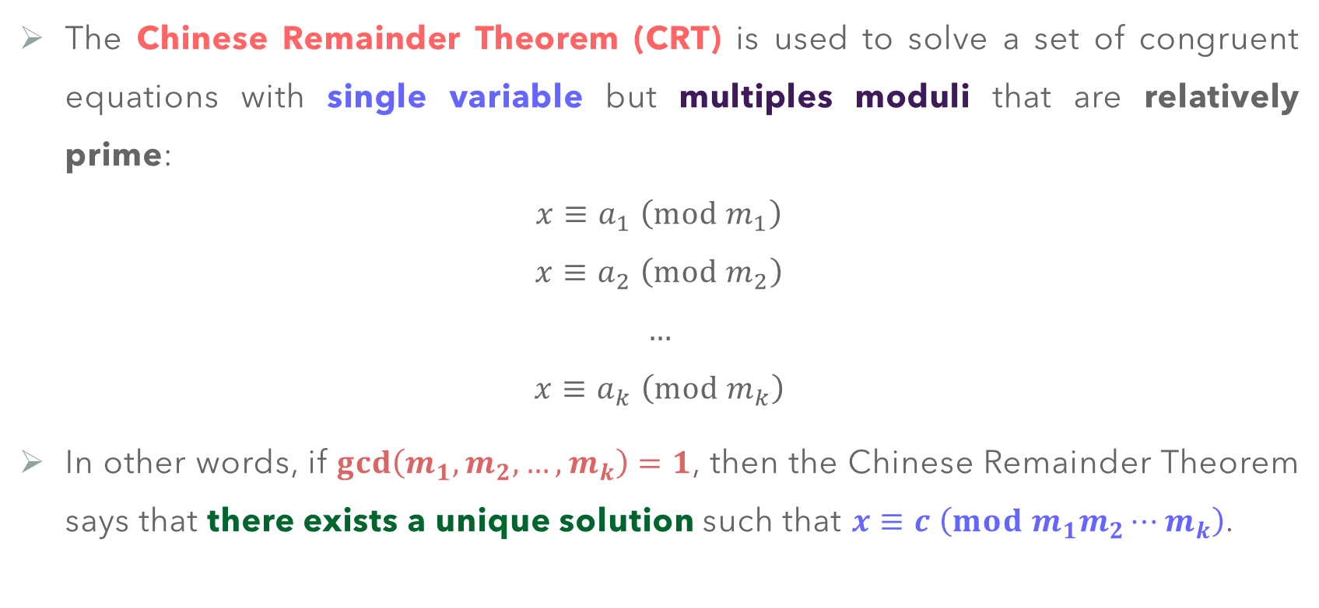
Chinese Remainder Theorem
The Chinese Remainder Theorem (CRT) is used to solve a set of congruent equations with single variable but multiples moduli that are relatively prime:
$$x≡a_{1} \left(mod m_{1}\right)$$
$$x≡a_{2} \left(mod m_{2}\right)$$
$$…$$
$$x≡a_{k} \left(mod m_{k}\right)$$
In other words, if $\gcd\left(m_{1},m_{2},…,m_{k}\right)=1$, then the Chinese Remainder Theorem says that there exists a unique solution such that $x≡c \left(mod m_{1}m_{2}⋯m_{k}\right)$.

Slide 54
Chinese Remainder Theorem
The CRT is believed to have been discovered by the Chinese Mathematician Sun-Tzu in around 100 A.D., which was how the term ‘Chinese’ appeared.
The original problem that gave birth to the CRT is as follows:
There are certain things whose number is unknown. If we count them by threes, we have two left over; by fives, we have three left over; and by sevens, two are left over. How many things are there?

Slide 55
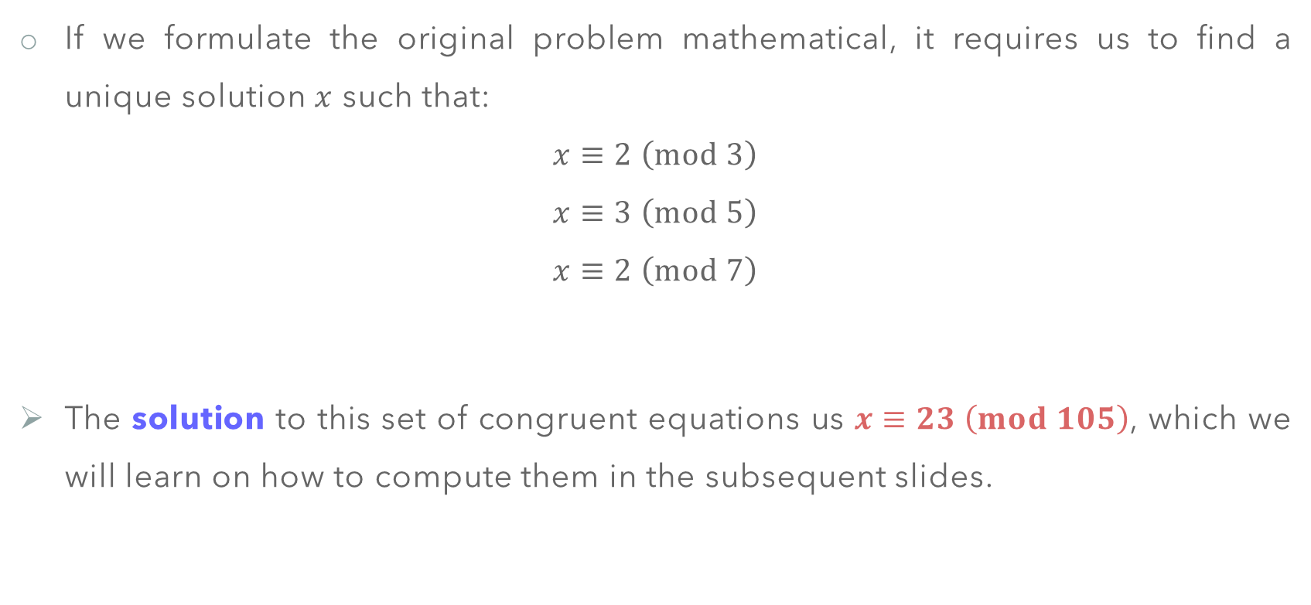
Chinese Remainder Theorem
If we formulate the original problem mathematical, it requires us to find a unique solution $x$ such that:
$$x≡2 \left(mod 3\right)$$
$$x≡3 \left(mod 5\right)$$
$$x≡2 \left(mod 7\right)$$
The solution to this set of congruent equations us $x≡23 \left(mod 105\right)$, which we will learn on how to compute them in the subsequent slides.

Slide 56
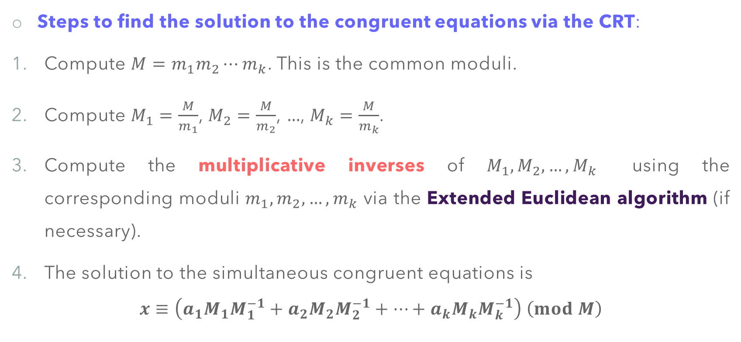
Chinese Remainder Theorem
Steps to find the solution to the congruent equations via the CRT:
Compute $M=m_{1}m_{2}⋯m_{k}$. This is the common moduli.
Compute $M_{1}=\frac{M}{m_{1}}$, $M_{2}=\frac{M}{m_{2}}$, $…$, $M_{k}=\frac{M}{m_{k}}$.
Compute the multiplicative inverses of $M_{1},M_{2},…,M_{k}$ using the corresponding moduli $m_{1},m_{2},…,m_{k}$ via the Extended Euclidean algorithm (if necessary).
The solution to the simultaneous congruent equations is
$$x≡\left(a_{1}M_{1}M_{1}^{−1}+a_{2}M_{2}M_{2}^{−1}+⋯+a_{k}M_{k}M_{k}^{−1}\right) \left(mod M\right)$$

Slide 57

Chinese Remainder Theorem
Example 8: Referring to the original problem, find the unique solution to the system of congruent equations:
$$x≡2 \left(mod 3\right)$$
$$x≡3 \left(mod 5\right)$$
$$x≡2 \left(mod 7\right)$$
Solution:
Compute $M=3×5×7=105$

Slide 58

Chinese Remainder Theorem
Compute $M_{1}=\frac{105}{3}=35$, $M_{2}=\frac{105}{5}=21$, $M_{3}=\frac{105}{7}=15$.
Compute each multiplicative inverses $M_{1}^{−1}≡2 \left(mod 3\right)$, $M_{2}^{−1}≡1 \left(mod 5\right)$, $M_{3}^{−1}≡1 \left(mod 7\right)$.
Compute the solution to the congruent equations:
$$x≡\left(2⋅35⋅2+3⋅21⋅1+2⋅15⋅1\right) \left(mod 105\right)≡233≡23 \left(mod 105\right)$$

Slide 59

Chinese Remainder Theorem
Why is the Chinese Remainder Theorem important in Cryptography?
It can be used to find the quadratic congruence in the form of $x^{2}≡a \left(mod n\right)$.
It is used in designing the RSA-CRT cryptosystem. An RSA variant that uses multi private keys in encryption, and signature schemes.
It can also be used in cryptanalyzing the Multi-prime RSA cryptosystem under suitable condition.

Slide 60

Chinese Remainder Theorem
Exercise 3: Using the Chinese Remainder Theorem, find a solution to the system of congruent equations of:
$$x≡3 \left(mod 7\right)$$
$$x≡3 \left(mod 13\right)$$
$$x≡0 \left(mod 12\right)$$

Slide 61
FAST EXPONENTIATION ALGORITHM

Slide 62

Fast Exponentiation Algorithm
Basic Mathematics about Exponentiation and Logarithm.
Exponentiation and Logarithm are inverses of each other.
$$y=a^{x} ⟺ x=\log_{a}{y}$$
In cryptography, we are interested in the modular exponentiation, which utilized in the RSA cryptosystem in both the encryption and decryption operations, where:
$$y=a^{x} \left(mod n\right)$$

Slide 63

Fast Exponentiation Algorithm
Unfortunately, there is no efficient way to perform such an operation in most computer languages, especially when the exponent is very large (says 1024 or 2048 bits).
Hence, the Fast Exponentiation Algorithm is devised to provide an efficient way to complete this task. It uses the square-and-multiply technique by first converting the exponent into binary digits of $n_{b}$ bits (from $x_{0}$ to $x_{n_{b}−1}$).
Example: $11={\left(1011\right)}_{2}$. Then $a^{11}=a^{{\left(1011\right)}_{2}}=a^{8}×1×a^{2}×a^{1}$

Slide 64
Fast Exponentiation Algorithm

Slide 65
Fast Exponentiation Algorithm

Slide 66

Fast Exponentiation Algorithm
The main idea behind the square-and-multiply technique:
The technique starts with the rightmost bit (Least Significant Bit, LSB).
If the bit $n_{b}=0$, then only squaring operation is performed.
If the bit $n_{b}=1$, then squaring operation is performed, followed by multiplication operation.
The fast exponentiation algorithm runs in the complexity of $𝒪\left(n_{b}\right)$, which is polynomial (efficient).

Slide 67

Fast Exponentiation Algorithm
Example 9: Find the modular exponentiation of ${17}^{22} \left(mod 21\right)$ using the fast exponentiation algorithm.
Solution: The exponent $22={\left(10110\right)}_{2}$, hence the square-and-multiply processes are

Slide 68

Fast Exponentiation Algorithm
Hence, ${17}^{22} \left(mod 21\right)≡4$.

Slide 69



Fast Exponentiation Algorithm
Since $23={\left(10111\right)}_{2}$, using fast exponentiation algorithm, we compute and found ${320}^{23}\left(mod 461\right)≡373$.
$$x_{i}$$ | Multiplication | Squaring
1 | $$1⋅320≡320 \left(mod 461\right)$$ | $${320}^{2}≡58 \left(mod 461\right)$$
1 | $$320⋅58≡120 \left(mod 461\right)$$ | $${58}^{2}≡137 \left(mod 461\right)$$
1 | $$120⋅137≡305 \left(mod 461\right)$$ | $${137}^{2}≡329 \left(mod 461\right)$$
0 |  | $${329}^{2}≡367 \left(mod 461\right)$$
1 | $$305⋅367≡373 \left(mod 461\right)$$

Slide 70
Main References for Chapter 7
Forouzan, B.A. “Introduction to Cryptography and Network Security”, Third Edition, McGraw-Hill, 2008.
Stallings, W. “Cryptography and Network Security: Principles and Practices”, Fifth Edition, Pearson Prentice Hall, 2011.

Slide 71
~ THE END ☺ ~

